Slide 1
Infrastructures for Next Generation Ultrabroadband and Mobile Networks
Francesco Matera
Fondazione Ugo Bordoni, Via del Policlinico 147, Roma, fmatera@fub.it

Slide 2
Outline
Introduction to 5G: Fiber to support 5G
Short overview on Fiber systems and networks
Optical Fiber Access (PON)
5G Overview
Fiber optics for 5G (New Access Network, costs!)
Slicing: Software Defining Network (SDN)& Network Function Virtualization (NFV)
Slicing-SDN FUB model: Carrier Ethernet approach
Experimental tests.
Next steps: Information Centric Networks
Conclusions

Slide 3
User Infrastructure Network Trend
Wireline
Wireless
ADSL
2G
3G
FTTC-VDSL
4G
5G
FTTH:FTTA
Fiber to the x (FTTx), x: Curb, Home, Antenna

Slide 4
Network Segments
Core: Wide Geographical networks
Metro: ring+WDM
Access: up to the Home (xDSL, Fiber,…)
Domestic: Wi-Fi, Plastic Optical Fiber, UDP,…
RAN: Radio Access Networks
XHAUL: From Antenna to the core

Slide 5
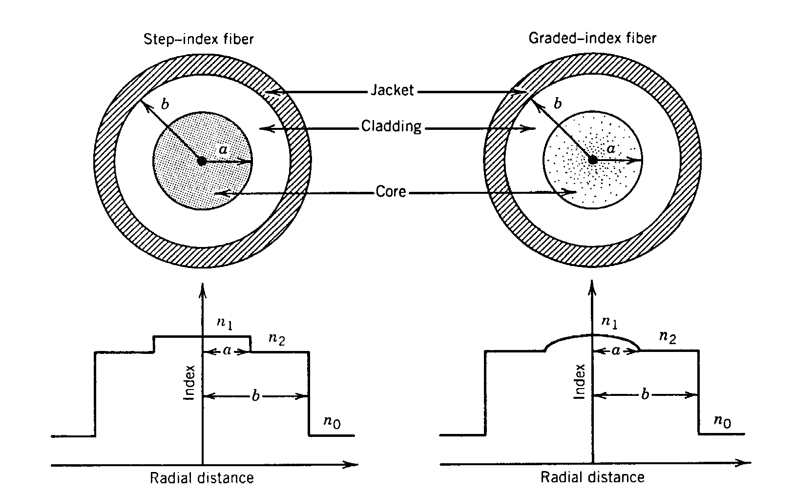
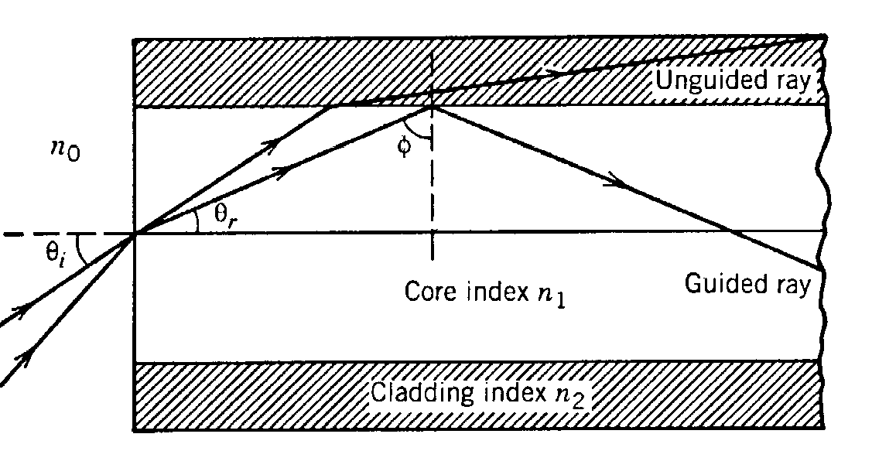
Short Optical Fiber Overview
3.0
First
Window
STD SMF
2.5
Second
Window
ZWP SMF
2.0
1.5
Third
Window
ATTENUATION (dB/km)
1310nm
850nm
1.0
1550nm
0.5
800
900
1000
1100
1200
1300
1400
1500
1600
1700
Step-index (G.652) Multicore
WAVELENGTH (nm)

Slide 6
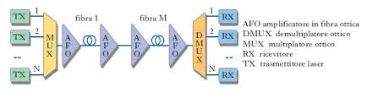
Optical Transmission Systems
IM-DD (intensity Modulation Direct Detection)
Coherent Systems (field detection)
Multilevel System
Wavelength Division Multiplexing (WDM)
Orthogonal Frequency Division Multiplexing

Slide 7
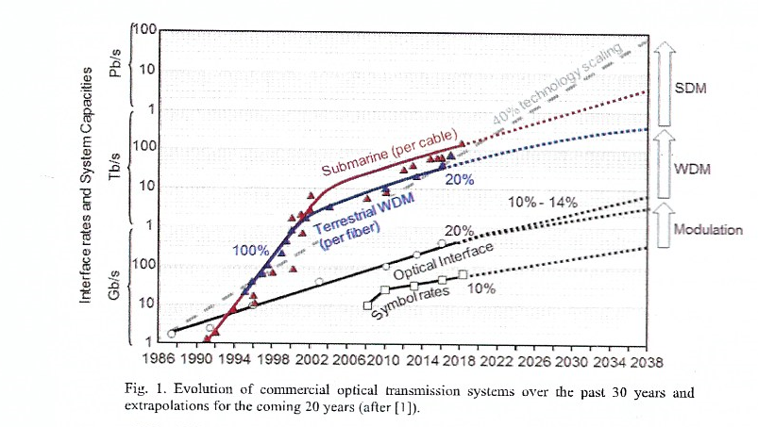
Link Capacity

Slide 8
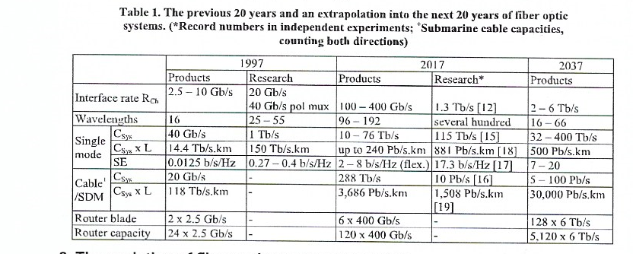
Examples of Optical Transmission Systems

Slide 9
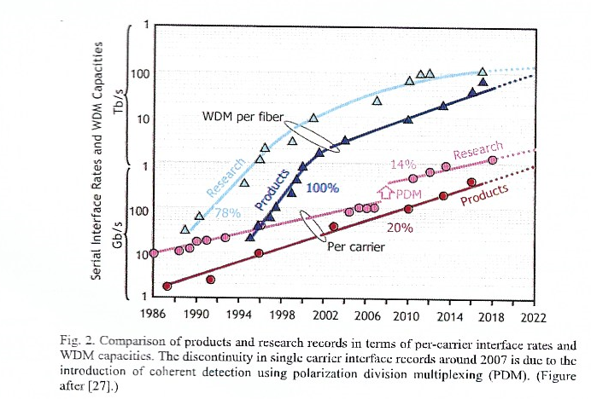
Research vs Products

Slide 10
Access Network Evolution
Dedicated / leased line
Distribution point (box)
Primary cable
Distribution cabinet
Central office
Twisted pair
Secondary cable
Feeder / primary
network
Distribution / secondary
network
Home
network

Slide 11
Access network
Central Office
500-1000 m
100-300 m
50-200 m
First Cabinet
Cavo
Second Cabinet
DSLAM
a) Best current architecture
b) Fiber to the cabinet
First Cabinet
Switch/
Router
Fibra ottica
DSLAM

Slide 12
Towards FTTB
First Cabinet
Second Cabinet
Switch/
router
Fibra ottica
DSLAM
c) Fiber to the curb
Switch/
router
Fibra ottica
D
d) Fiber to the building

Slide 13
FTTH
Switch/
router
Fibra ottica
e) Fiber to the home

Slide 14
FTTH Architectures
Central
office
a)
Central
office
Curb
switch
b)
Passive Optical Networks (PON)
Central
office
c)
Splitter
ottico

Slide 15

GbE based: i.e. FASTWEB in 2000
Daisy chain architecture
Core

Slide 16
Passive Splitters
1x2 Splitter
1xN Splitter
The basic element consists of two fibers fused together
Every time the signal is split two ways, the signal is reduced by 10log(0.5)=3dB
  Loss ~3dB x log₂(#ONUs)
Conventional
Low-loss
Splitter 1x2
3.7dB
3.4dB

Slide 17
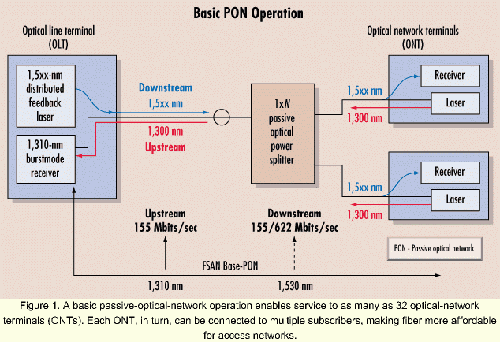
PON Scheme
The optical line terminal (OLT) broadcasts data downstream on 1,510 nm and the ONTs burst data back upstream on 1,310 nm in their assigned time slots.
Ethernet PON (EPON)
GPON (based on synchronous SDH frame)

Slide 18

Downstream Traffic Scheduling
OLT schedules traffic inside timeslots
-Time Division Multiplexing (TDM) scheme
Time slots can vary from ∼μs to ∼ms
A
A
B
C
B
OLT
A
B
C
B
A
B
C
B
B
Passive Splitter
A
B
C
B
C

Slide 19

Upstream Traffic (1)
All ONUs share the same upstream channel
  ONUs cannot exchange data directly
  Collisions may occur at the splitter/combiner
ONU
OLT
ONU
Passive Splitter
ONU

Slide 20

Upstream Traffic Scheduling (2)
In general, PON standards propose Time Division Multiplexing Access (TDMA) schemes
  Upstream time slicing and assignment
ONU
A
B
C
B
A
ONU
OLT
B
B
Passive Splitter
C
ONU

Slide 21

Upstream Frame Reception
The OLT receives frames with different powers
  Much difficult to recover synchronism (clock and data recovery)
  Burst Mode Receiver (complex) @ OLT
    Sets 0-1 threshold on a burst basis
A
A
Automatic Gain Control to adjust 0-1 threshold at the beginning of each received burst
7 km
B
B
OLT
A
B
3 km
Passive Splitter
C
1 km

Slide 22
Evolution of the standards
NG-PON2
4x10 Gb/s
XGPON (10 Gb/s)
10 GB EPON
22

Slide 23
Ethernet PONs (EPONs)
All packets carried in EPON are encapsulated in Ethernet frames
  Support for variable size packets
Similar wavelength plan to BPON
Maximum bit rate is 1Gbps MAC-MAC (1.25 Gbps at the physical layer with 8b/10b line coding)
Minimum number of splits is 16
Maximum reach is
  10 km (FP-LD @ ONUs, limited by dispersion in downstrea for G.652)
  20 km (DFB-LD @ ONUs)
Different configurations are allowed

Slide 24
EPON Downstream Traffic
Similar to a shared medium network
Packets are broadcasted by the OLT and selected by their destination ONU
ONU 1
1
1
USER 1
1
3
1
2
1
3
1
2
1
3
1
2
ONU 2
2
USER 2
OLT
1
3
1
2
802.3 frame
Header
Payload
FCS
ONU 3
3
USER 3

Slide 25
EPON Upstream Traffic
ONUs synchronized to a common time reference
Centralized arbitration scheme OLT based
OLT grants access to ONU for a timeslot
  Several Ethernet packets
Frames Buffer
ONU 1
1
1
USER 1
1
1
1
1
2
3
3
3
2
ONU 2
2
OLT
USER 2
Time slot
802.3 frame
3
3
3
ONU 3
3
3
3
USER 3
Header
Payload
FCS

Slide 26
GPON Main characteristics
(G.984.1 Service Requirements)
Item
Target
Bit rates
1.25Gbit/s symmetric or higher (2.4 Gbit/s).
Asymmetric with 155/622Mb/s upstream
Physical reach
Max. 20 km or max. 10 km
Logical reach
Max. 60 km
Branches
Max. 64 in physical layer
Wavelength allocation
Downstream: 1480 – 1500nm
Upstream: 1260 – 1360nm
Downstream video wavelength (1550 – 1560nm) may be overlaid

Slide 27
GPON Encapsulation Mode (GEM)
GEM provides a Generic Frame where to carry both TDM and packet traffic over fixed data-rate channels
  Similar Generic Framing Procedure (GFP) used in SDH/SONET
A Generic Frame consists of:
  a core header
  a payload header
  an optional extension header
  a payload
  an optional frame check sequence (FCS).
PCBd
n
Payload n
PCBd
n+1
Payload n+1
PCBd
n+2
T_{P-Frame} = 125 µs
“Pure” ATM cells
Section
TDM & Data Fragments
over GEM Section
N * 53 bytes

Slide 28
Technical Standards Comparison
Technology | Standard | Downstream/ Upstream Bandwidth | # ONT served | Lambda | Framing/ Protocol | Distance
APON/BPON (ATM PON/ Broadband PON) | ITU-T G.983.x | 155, 622 or 1244 Mbit/s down 155 or 622 Mbit/s up | Limited by power budget and ONU addressing limits: 16 to 32 splitter | 1490 nm Down 1310 nm Up (1550 nm Down for RF video ) | ATM | 20 km
GPON (Gigabit PON) | ITU-T G.984 | 1.2 or 2.4 Gbit/s down 155, 622, 1.2 or 2.4 Gbit/s up | Up to 64(physical) Up to 128 (logical) | 1490 nm Down 1310 nm Up (1550 nm Down for RF video) | GEM: G-PON Encapsulation Method (supports Ethernet), ATM | 10/20 km (up to 60 km )
EPON (Ethernet PON)* | IEEE 802.3ah | Symmetric 1.25 Gbit/s | Up to 16 | 1550 nm Down 1310 nm Up | Ethernet | 10/20 km
10GEPON (10 Gigabit Ethernet PON) | IEEE 802.3av (Working Task Force) | 10 Gbit/s down 1 Gbit/s up (symmetric 10 Gbit/s in the future?) | 32 (maybe more?) | 1480-1500 nm Down ? 1260-1360 nm Up ? 1550-1560 Video overlay ? | Ethernet | 20 km

Slide 29
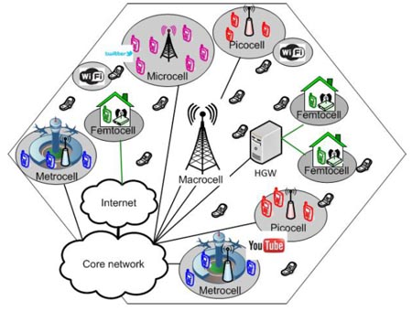
5G Main Characteristics
  From 2G to 4G: Capacity increasing
  HetNet: macrocellS AND small cells (micro, pico, femto, relay).
    Network Densification
    More capacity, less latency
  Coverage
    According to required SNR for service.
    QoS/QoE.
  Coexistence.
  Handover
  New band frequency: 700 MHz (deep indoor), 3.6 GHz (BB enhancement), 26 GHZ
Figura tratta da: INFOTECH OULU ANNUAL REPORT 2014 - RADIO ACCESS TECHNOLOGIES (RAT)
Professor Matti Latva-aho
http://www.oulu.fi/infotech/annual_report/2014/rat

Slide 30
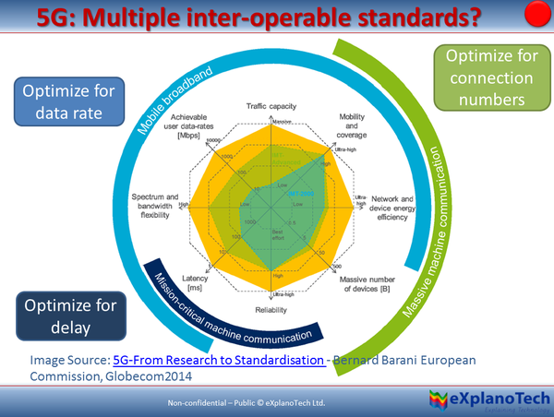

Slide 31
5G Services
Enhanced Mobile Broadband (eMBB):
  High capacity
  Higher radio bandwidth
Massive machine type communications (mMTC):
  Machine to Machine (M2M) (not IP necessary)
  Internet of things (IoT)
  High density devices
Ultra-reliable and low latency communications (URLLC):
  Tactile, driving,….

Slide 32
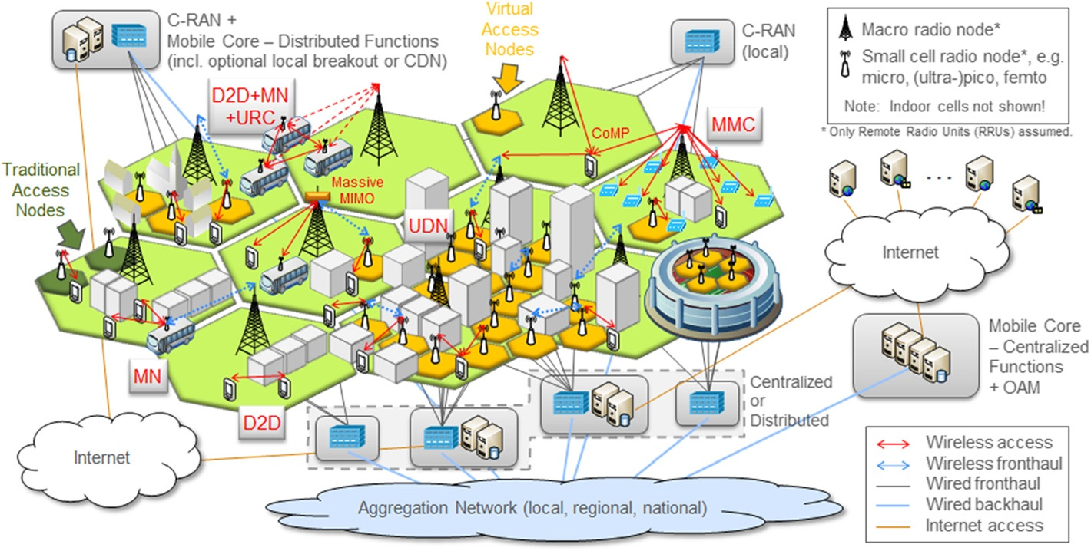
Rete 5G (HetNet)

Slide 33
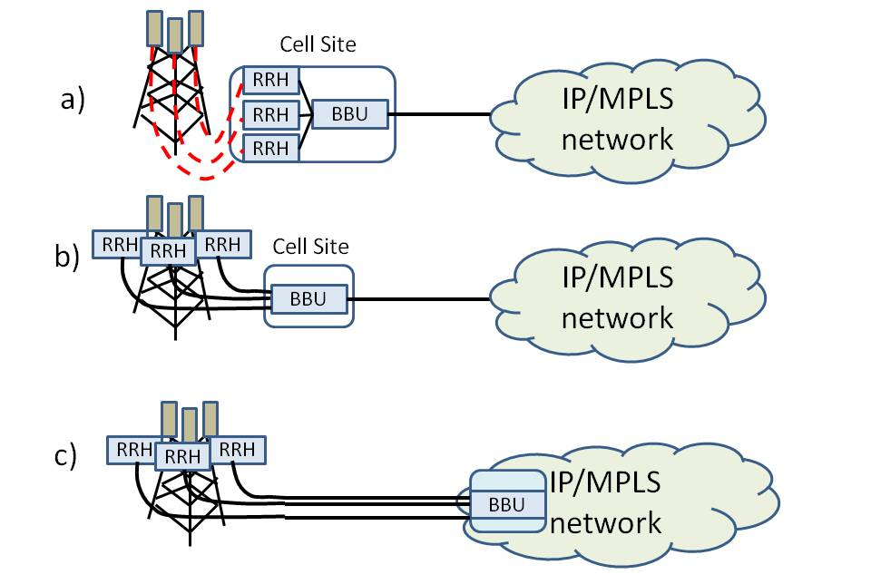
Centralized/Cloud Radio Access Network evolution
backhauling
Fronthauling
BBU: Band Base Unit, RRH Remote Radio Unit
Fast data elaboration
(Edge, FOG Computing)
d)

Slide 34
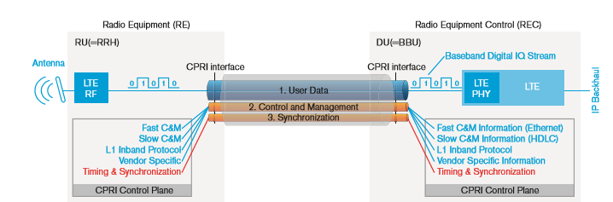
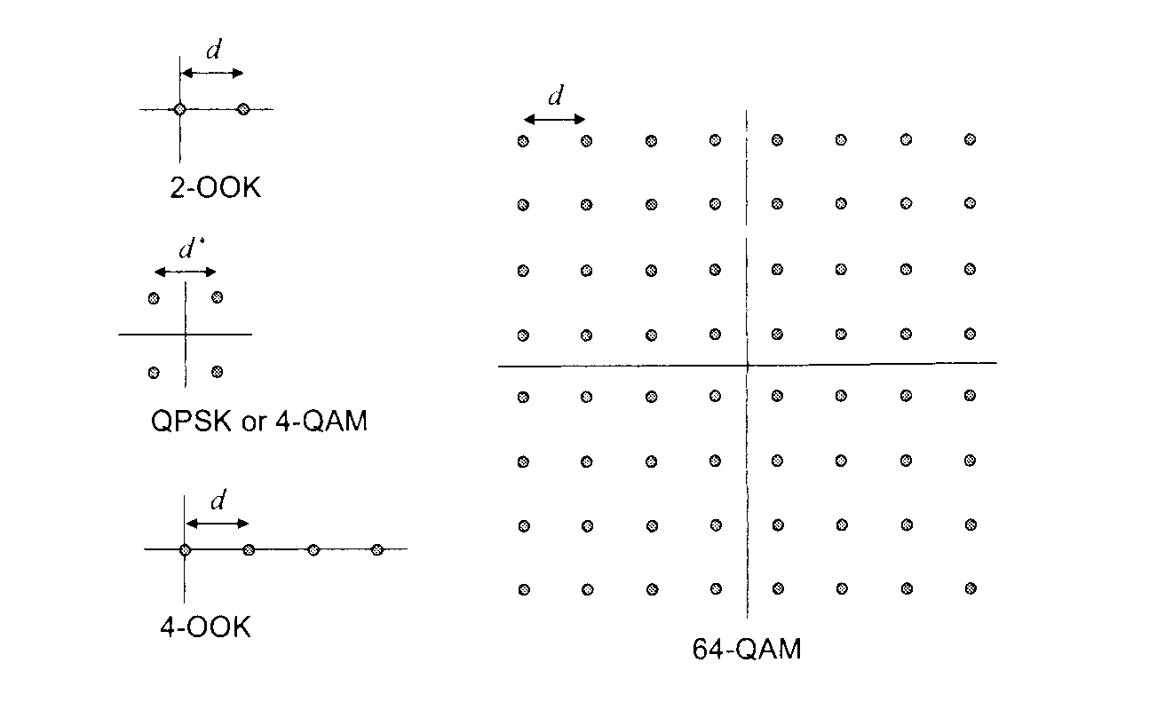
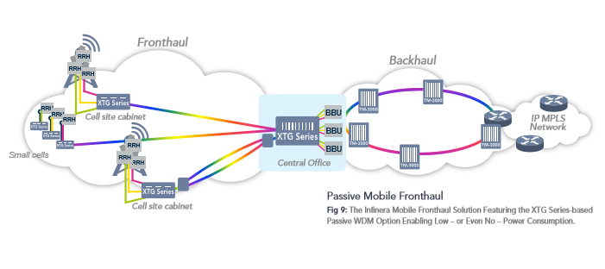
Fronthauling (Digital Radio Over Fiber)
From RF Multilevel
to optical digital.
Bandwidth explosion (x14!)
Analogic Radio Over Fiber: Direct RF to Optical Conversion

Slide 35
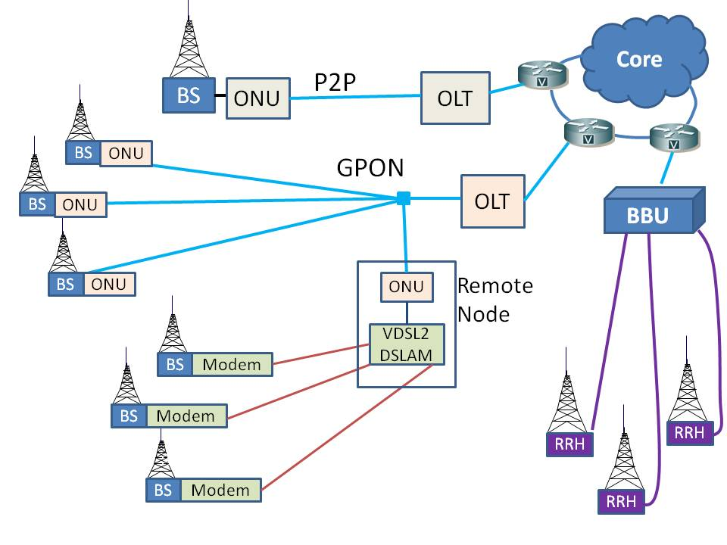
Next GenerationAccess Network for 5G
Backhauling
Fronthauling

Slide 36
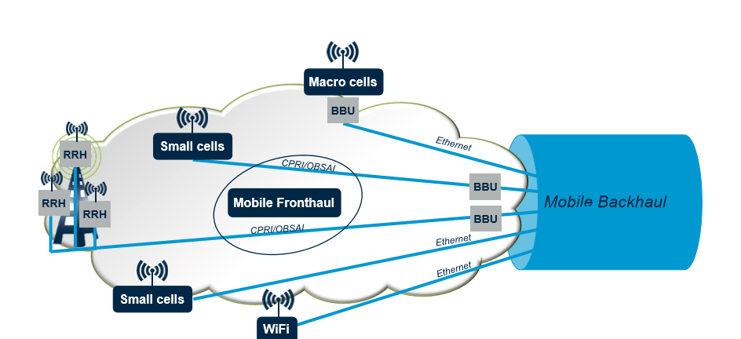
Backhaul vs Fronthaul

Slide 37
Example of eBBM
Model for RAN taken from EARTH FP7 Project, Ideal Manhattan-like grid, ..
Cellular layout (Grazioso et al Fotonica 2018)
  an umbrella macrocell with omni antenna located at the centre of the area and 30 m high
  a variable number of identical microcellular base stations 10 m high
Overall throughput computed as:
T_{syst} = W N_{site} N_{sect} S_{eff}
Where W is the allocated bandwidth in MHz (20 MHz) , N_{site} is the total number of BS/RRH sites, N_{sect} is the number of sectors per cell site and S_{eff} is the spectral efficiency in b/s/Hz/sector.
  S_{eff} =3.8 and 4.2 for macrocells (1.8 GHz) and microcells (3.5 GHz) respectively.
  Modules of 228 Mb/s for macro and 84 Mb/s for microcell.
          1 Macrocell+23 microcell

Slide 38
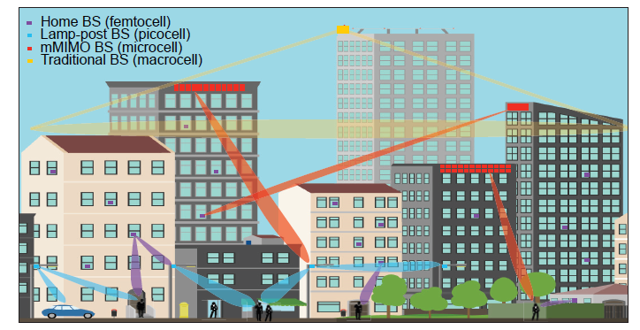
26-28 GHz new radio: Radio beams

Slide 39


26-28 GHz for rural Areas
Backbone
39

Slide 40
26-28 GHz other examples
Verizon
Open Fiber
Transportation

Slide 41
IoT Contest
Smart grid, tactile, robotic, Automotive, domotic,…
Massive data
Different solutions:
  Based on 2G, 3G, 4G (LTE-Machine Type Communication, MTC)
  Proprietary solutions: i.e. LPWA (Low Power Wide Area) Networks (LoRa, SigFox, e WMBus)
Different approach for storage and elaborations
Security
Distributed management
Distributed legend: Blockchain

Slide 42
IoT automatic transportation
Smart road
Automatic drive
  Radar, lidar, video
  Fast elaboration
  Close repository
EDGE Computing
FOG Computing (more performance in terms of computing by means of suitable devices)
42

Slide 43
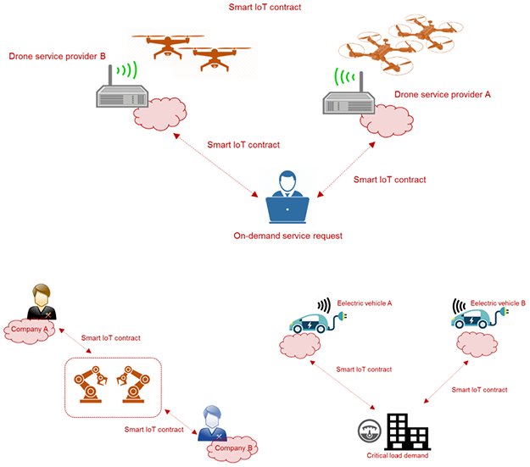

Slide 44
Access Infrastructure costs
4 different areas for building density and Real Estate Units (unità immobiliari, U.I). Supposing a mix of different trenchs and existing infrastructures. MISE model (28 M U.I.)
AA High Building density (Buildings/kmq>100) and High HU for building (HU/builging>4.5)
AB High Building density (Buildings/kmq>100) and low HU for building (HU/builging<4.5)
BA Low Building density (Buildings/kmq<100) and High HU for building (HU/builging>4.5)
BB High Building density (Buildings/kmq<100) and High HU for building (HU/builging<4.5)
Costi medi primaria per U.I. (euro)
AA=120;
AB=170;
BA=200;
BB=300
Costi medi secondaria per U.I (euro)
BB=1492;
BA=658;
AB=457;
AA=332;
Cost for verticals(FTTH) 250 euro for all

Slide 45
Area AA
Area AB
Area BA
Area BB
Base FTTB for alll
FTTH
From FTTC to FTTB
Costs (billion euro)
5G
for FTTC
Base FTTC
Penetration (%)

Slide 46
Vectoring
No vectoring
Percentuale di 100 Mb/s (%)
Costi (miliardi euro)
30 Mb/s a tutti e 100 Mb/s al 50% U.I. con 6.5 Miliardi di Euro (Vect)

Slide 47
Slicing (1)
The whole access-metro-core network establishes multiple networks
  optimized to each different service and key capability.
This is the Slice.
Each one is comprised of a set of network functions that are selected for a specific service
In details the operator's physical network is sliced into multiple virtual and end-to-end (E2E) networks and each slice is logically isolated.
A. Valenti et al“Experimental Investigation of Quality of Service in an IP All-Optical Network Adopting Wavelength Conversion” IEEE/OSA J. of Optical Communications and Networking, Vol. 1, Issue 2, pp. A170-A179, July 2009

Slide 48
Slicing (2): 3GPPP approach
3GPP: Network Slicing Istances: Preparation, Commissioning, Operation, Decommissioning;
Depending on the service type (eMBB, URLLC, mIoT), different service types may include different service requirements information for network slicing, for example: Area traffic capacity requirement, Charging requirement, Coverage area requirement, Degree of isolation requirement, End-to-end latency requirement, Mobility requirement, Overall user density requirement, Priority requirement, Service availability requirement, Service reliability requirement, UE speed requirement
Operator management system (OMS) to OMS interface for multi-operator NSI creation

Slide 49
Our Slicing approach
Logical Subnet implementation based on Carrier Ethernet approach;
Exploitation of Fiber Access Networks (GPON vs NGPON2)
QoS monitoring: mPlane measurement plane
Experimental tests on a Geographical Area Network Test bed;
Emulation of LTE and WiMax (NS3)
Simple SDN management approach
Reliability and latency

Slide 50
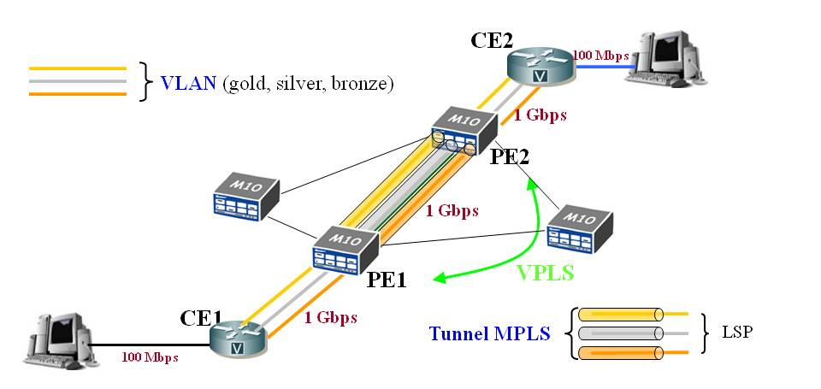
Slicing: Encapsulation from VLAN to Virtual Private LAN Service (VPLS) to PBB-TE
Provider Backbone Bridging Traffic Engineering (PPB-TE) is a Carrier Ethernet approach

Slide 51
Software Defined Networks
SDN adopts a separation of the control and data plane;
it uses a central entity (Controller, Orchestrator).
OpenFlow is the most well known protocol that rules the communication between Controller and switches.
Other protocols for SDWR: Route flow, Flow N and Flow Visor;
Based on Network Function Virtualization (NFV) the Routing function are managed by the Controller
51

Slide 52
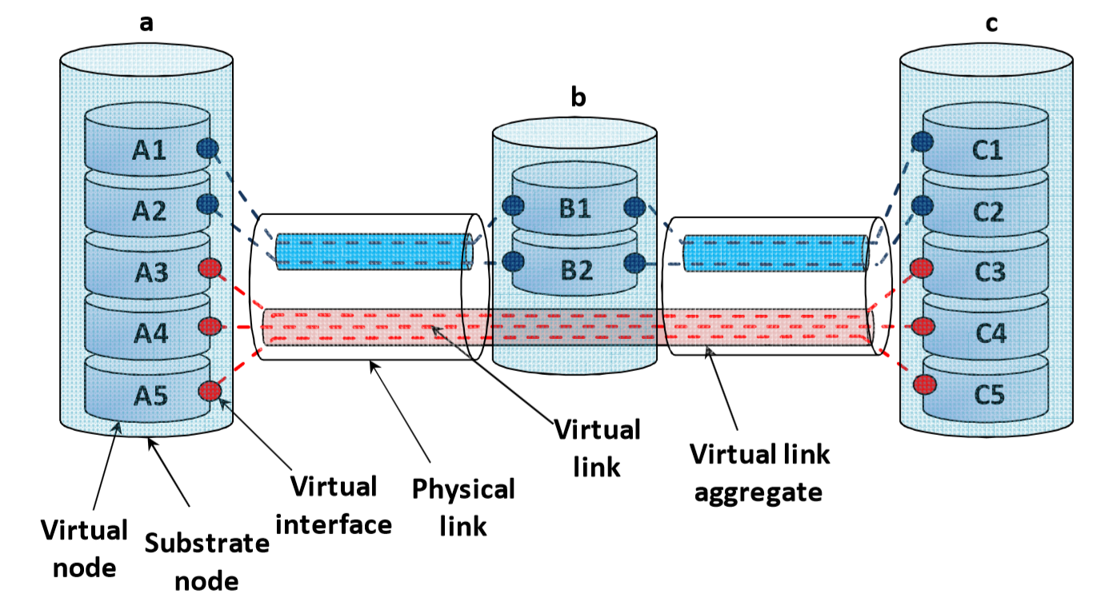
Centralized SDN
SDN
Orchestrator
Openflow
All the Layer OSI routing funcions can be managed by the Orchestrator; We only consider L1-2-3, since they allow to adopt current devices: Simple Network Management Protocol (SNMP) adopted [Tego E.,et, J. of Elect. and Comp. Engin., March 2014]

Slide 53
Centralized vs distributed SDN
Centralized SDN Problems:
  Scalability (Wide Geographical Area Networks);
  Reliability and Security
  Multioperator Environment: who wins?
Distribuited Controller [J. Xie et al , “Control plane of..” Comput. Commun. V. 67, pp-1-10, 2015].
To meet the requirement of centralized view of the network controllers such as Onix, Hyperflow, ONOS, OpenDayLights share infromation among each other. [H. Tahaei et al, IEEE Access, v. 6, 2018]
Controllers have to synchronize their state with each other.
Synchronization causes network overhead. Control in data plane

Slide 54
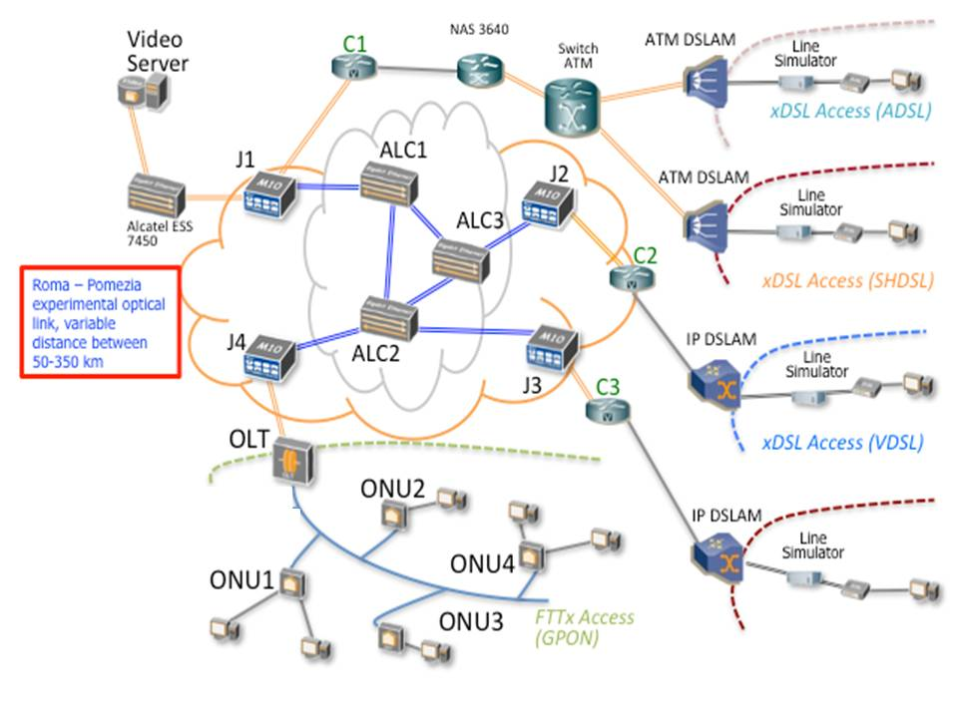
LAB ISCOM
5G
NGPON2
GPON

Slide 55
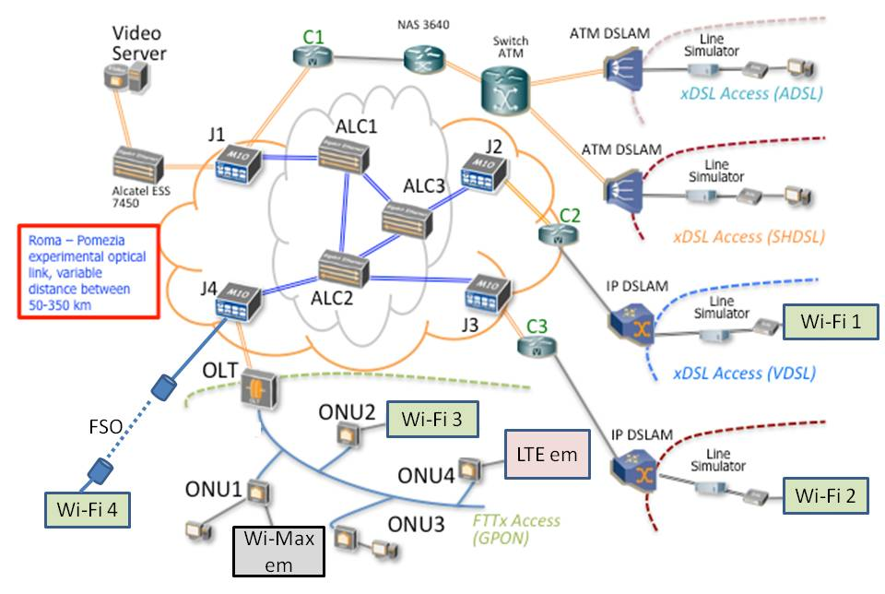
Slicing: LAB ISCOM
5G
c)
d)
b)
a)

Slide 56
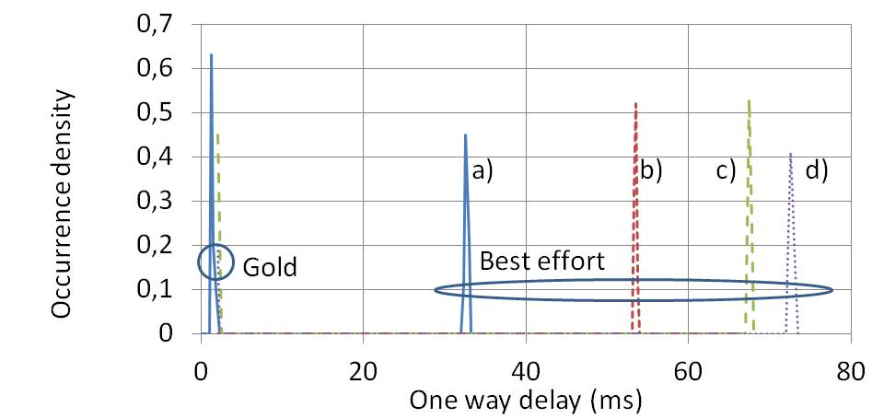
Latency with slicing
Matera F., et al. “Optical Network Slicing Approaches with Carrier Ethernet test” IEEE Fotonica 2017
With NG-PON2 Latency<0.2 ms! S. Pompei et al submitted to IEEE Fotonica 2018

Slide 57
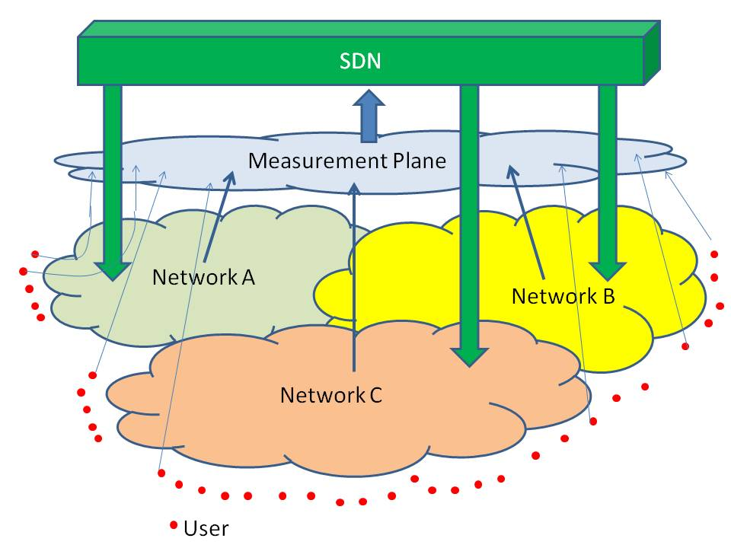
FUB: SDN+Measurement plane

Slide 58
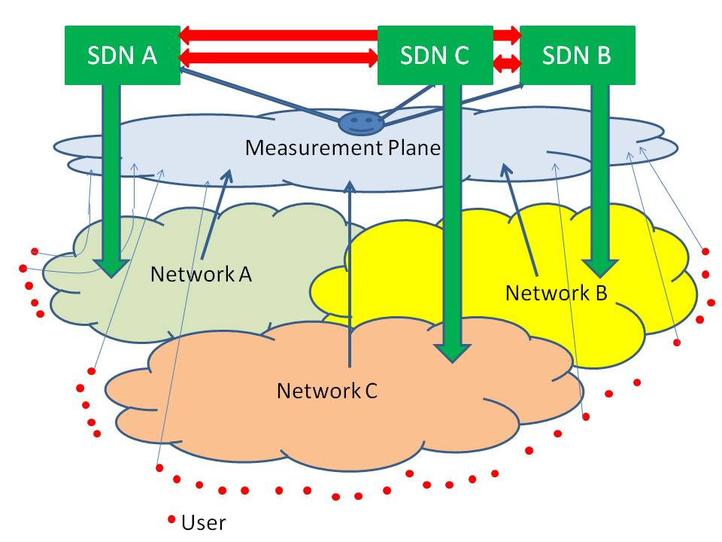
SDN Distributed Controller

Slide 59
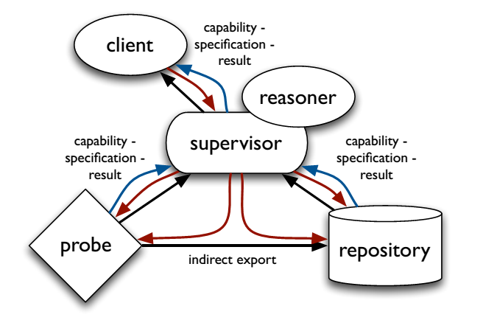
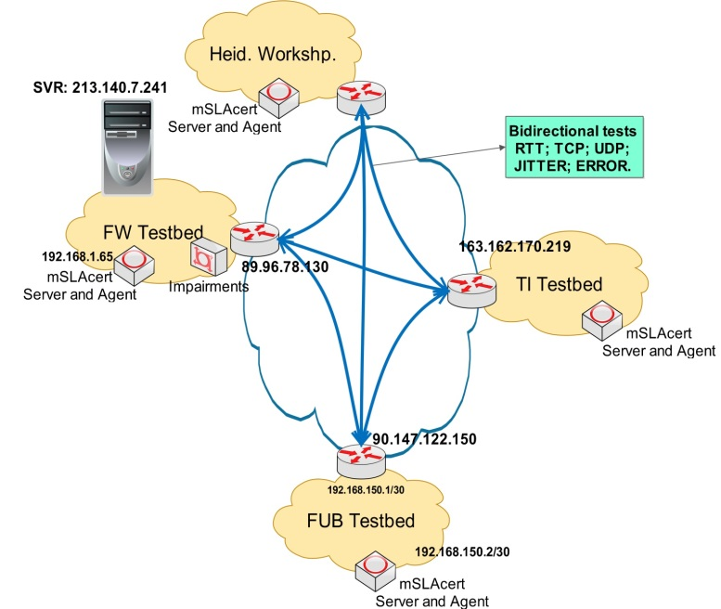
mPlane architecture (EU FP7)
SDN
Estimating content and service popularity,
Anomaly detection and root cause analysis,
Passive content promotion and curation,
Multimedia content delivery,
QoE for web browsing,
Mobile network performance,
SLA verification and certification
Active Probe: QoS (throughput, jitter, packet loss, traceroot, ping
Passive probe: traffic monitoring
E. Tego, et al "Unveiling network and service performance degradation in the wild with mplane" IEEE Communication Magazine, March 2016, pp. 71-76

Slide 60
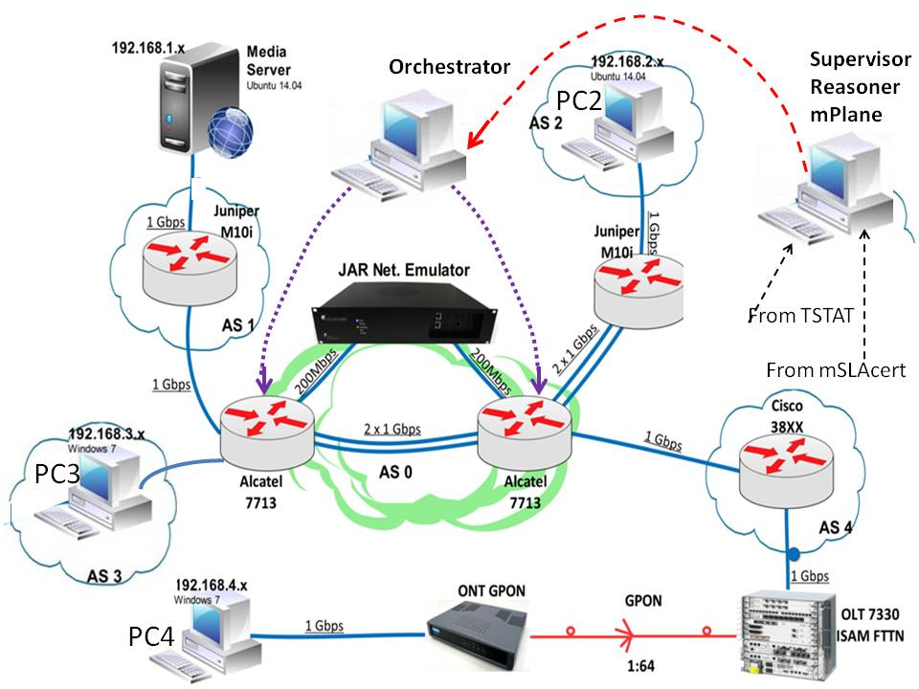
SDN
SDN-mPlane test (1)

Slide 61
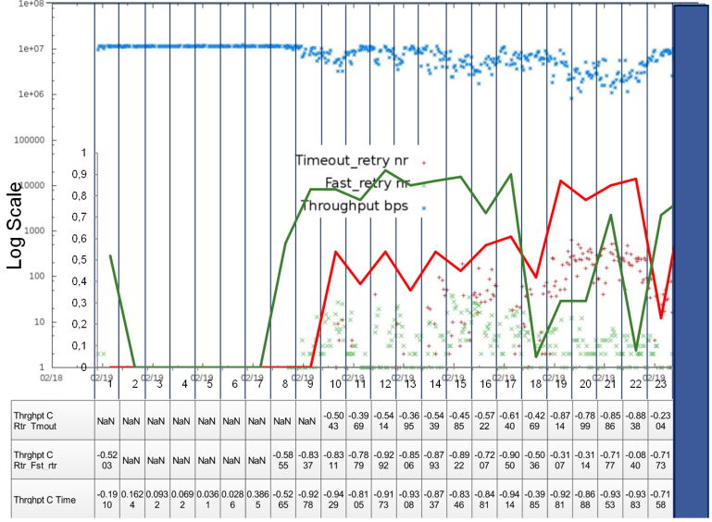
SDN
SDN-mPlane test (2)
Weak congestion
Strong congestion
b)
a)
correlations between Throughput and Fast_retry (a) and between Throughput and Timeout_retry(b)
A. Valenti et al "Quality of Service monitoring adopting correlation among active and passive measurements" Networks 2016, Montreal September 2016.

Slide 62
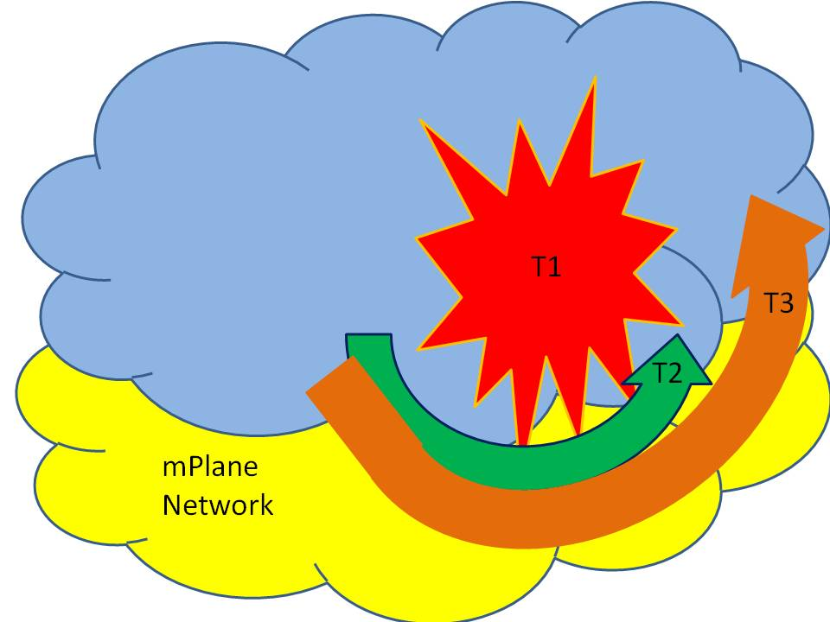
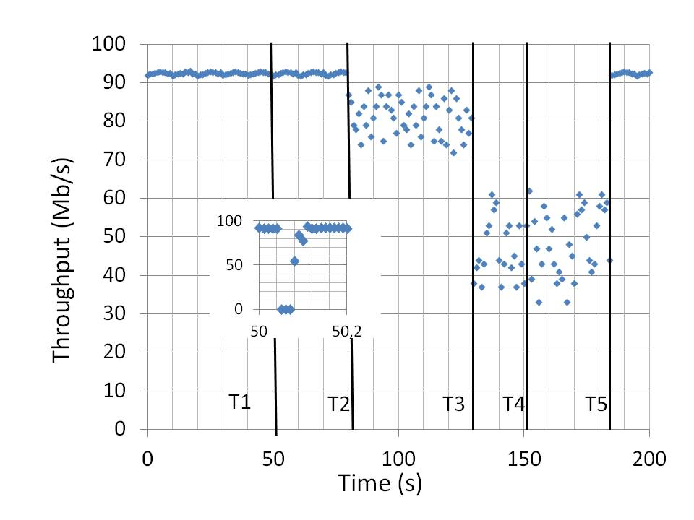
Slicing reliability: disaster recovery
E. Tego et al "A Measurement Plane for Optical Networks to Manage Emergency Events" Fiber and Integrated Optics, Taylor & Francis, published online December 13 2017, pp. 227-241.

Slide 63
Slicing case:
Next Generation Emergency Networks
migration of current emergency systems based on legacy telecommunication technology. Cooperation within IP?
Current emergency systems must be upgraded to operate in a full IP world
Procedures to assign reliable and secure paths and must monitor networks in order to avoid congestions and other impairments. See slicing before
Unique platform to manage all the emergency calls: NG112 (EENA)
Information from social networks. i.e. prog. EMYNOS (www.emynos.eu)

Slide 64
Information Centric Networks
ICN
Current host-centric (Server-client) Internet architecture is becoming inadequate for the modern services
Semantic networks: routing according content,
Information Centric Networks (Content Centric Networks):
  Content-Client: research according to name
  IP revolution: Broadcast searching for a “name” to all the nodes closest to client
  Router containing “name” send all its content to the client

Slide 65
ICN strategies
ICN
Cost analisys:
  Cost advantages with respect standard IP and CDN A. Araldo, M. Mangili, F. Martignon, D. Rossi, "Cost-aware cashing: optimizing cache povisioning and object placement in ICN", Globecom 2014, December 8-14 2014Austin USA
  More efficiency in Wavelength Routing and Assignment (RWA) M. F.Al-Naday, N. Thomos, M. J. Reed, "Information-Centric Multilayer Networking: Improving Performance Through an ICN/WDM Architecture" IEEE/ACM Transaction on Networking, vol. 25, n. 1, Feb. 2017
Power consumption:
  Servers+routers= CCN better than standard IP U. Lee, I. Rimac, V. Hilt, “Greening the Internet with Content-Centric Networking” Proceedings of the 1st International Conference on Energy-Efficient Computing and Networking, Passau, Germany — April 13 - 15, 2010
Slicing operating in a ICN Contest: https://www.cisco.com/c/dam/m/en_us/service-provider/ciscoknowledgenetwork/files/601_06_29-16-ICN_29Jun2016_CKN_Final.pdf

Slide 66
Conclusions
Towards Mobile Next Generation Networks
Towards FTTH and Fiber to the Antenna
Role of Radio Access with 5G
IoT transforms Architectures (FOG, EDGE) and data management (blockchain)
Dynamic management with SDN&NFV

