Slide 1
Il Partenatiato Esteso SERICS
Security and Rights in the Cyber Space
Alessandro Armando
Presidente Comitato Scientifico
CyberDays2024 Apr 21, 2024

Slide 2
SERICS (SEcurity and RIghts in the CyberSpace)
Partenariato Esteso relativo a “Tematica 7. Cybersecurity, nuove tecnologie e tutela dei diritti”
Soggetto attuatore: Fondazione SERICS
Start: Jan 1, 2023
Duration: 3 years
Avviso Pubblico “per la presentazione di Proposte di intervento per la creazione di “Partenariati estesi alle università, ai centri di ricerca, alle aziende per il finanziamento di progetti di ricerca di base” – nell’ambito del PNRR, Missione 4 “Istruzione e ricerca” – Componente 2 “Dalla ricerca all’impresa” – Investimento 1.3, finanziato dall’Unione europea – NextGenerationEU – Avviso nr. 341 del 15.3.2022.

Slide 3
Key data
27 Research Projects
126 new researchers
114M€ funding
41,3% of budget to the regions of Southern Italy
20% of budget for (Research) Open Calls
6% of budget for Innovation Open Calls
5% of budget for Cybersecurity Academy

Slide 4
Università e Istituti speciali

Slide 5
Enti di Ricerca
Aziende

Slide 6
Roadmap
Governance
Research
Innovation
Training

Slide 7
Governance

Slide 8
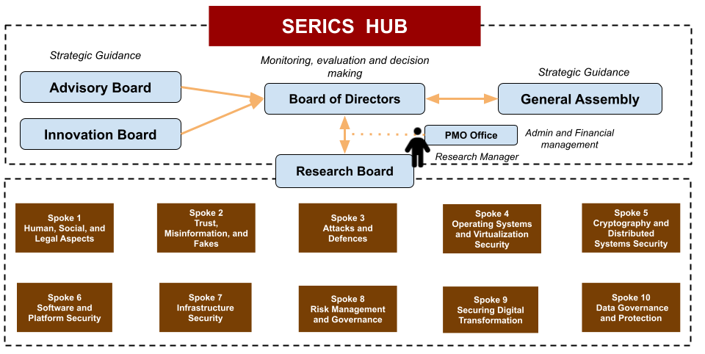

Slide 9
Research

Slide 10
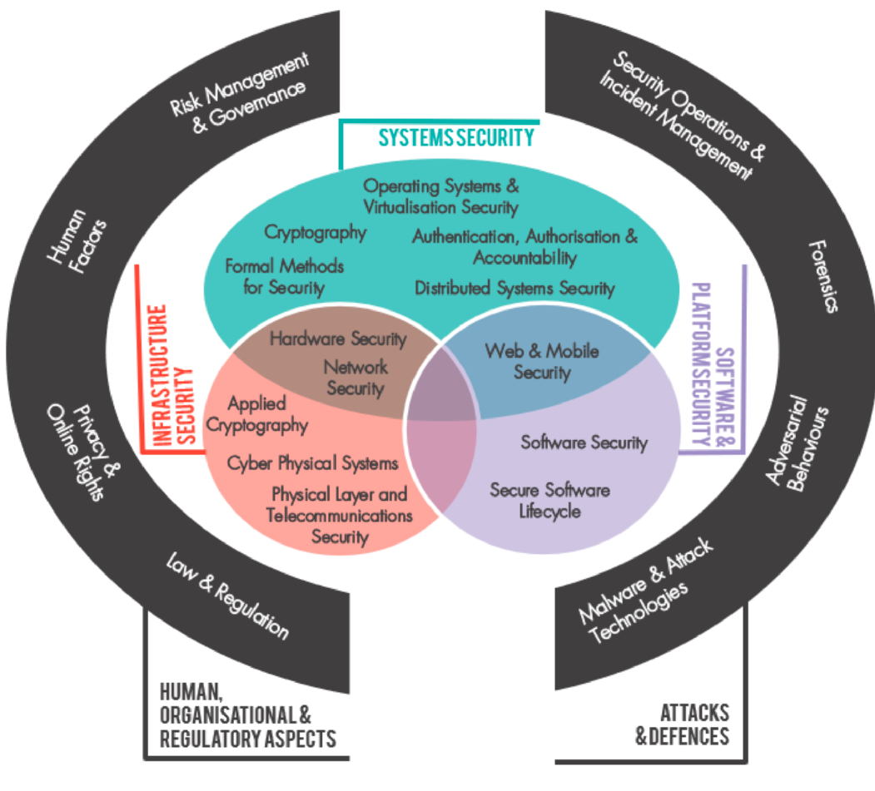
SERICS Thematic Areas
The Cyber Security Body Of Knowledge
https://www.cybok.org/

Slide 11
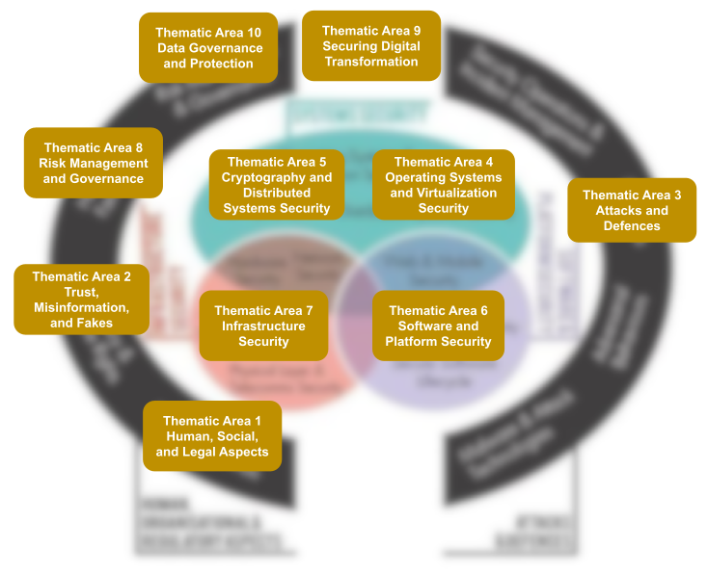
SERICS Thematic Areas
10 Thematic Areas
27 research projects
Each Thematic Area managed by a Spoke

Slide 12
Aree tematiche degli Spoke
Spoke 1 CNR: Human, Social, and Legal Aspects
Spoke 2 UNISA: Trust, Misinformation, and Fakes
Spoke 3 UNICA: Attacks and Defences
Spoke 4 UNIGE: Operating Systems and Virtualization Security
Spoke 5 UNICAL: Cryptography and Distributed Systems Security
Spoke 6 UNIVE: Software and Platform Security
Spoke 7 POLITO: Infrastructure Security
Spoke 8 UNIBO: Risk Management & Governance
Spoke 9 UNIROMA: Securing Digital Transformation
Spoke 10 UNIMI: Data Governance and Protection

Slide 13
Research Projects
Research activity structured in 27 collaborative research projects with
well defined objectives,
workplan (WPs and Tasks),
resources, and
principal investigator.
Research projects leverage
Personnel of partners
Newly appointed researchers
Open Calls (involvement of new, i.e., external partners)

Slide 14
Innovation

Slide 15
Innovation
fostering the migration of results to partner companies as well as to new companies through innovation open calls aimed to increase the TRL of the research results
facilitating access to the market of Cybersecurity solutions and services to young SME, and
stimulating creation of start-ups and spin offs and mobilization of innovative knowledge and entrepreneurial spirit within the community.

Slide 16
Training

Slide 17
Cybersecurity Academy
Support to PhD Courses (“summer/winter schools”)
Support to university-level masters
Classes on entrepreneurship tailored to undergraduates, graduates, PhD students, and PhD
Advanced training for employees/practitioners on selected topics (e.g. QKD, applied crypto, legal aspects, …)
Train the trainers

