Slide 1
Cybersecurity Landscape: how to avoid Costly Errors
(at low cost)
Giuseppe Bianchi
University of Roma Tor Vergata
Director, National CNIT Network Assurance & Monitoring LAB

Slide 2
Let’s start with some conclusions…
The best is the enemy of the good:
Let’s first focus on the low-hanging fruit
(i.e., the many trivially identifiable and easily fixable issues)
But don’t stop here:
a mandatory base for… further improvement!

Slide 3
Outline
1. How things can go (badly!) wrong…
  learning from examples
2. What to do?
  at the very minimum
  Institutions might help? Yes! (some proposals)

Slide 4
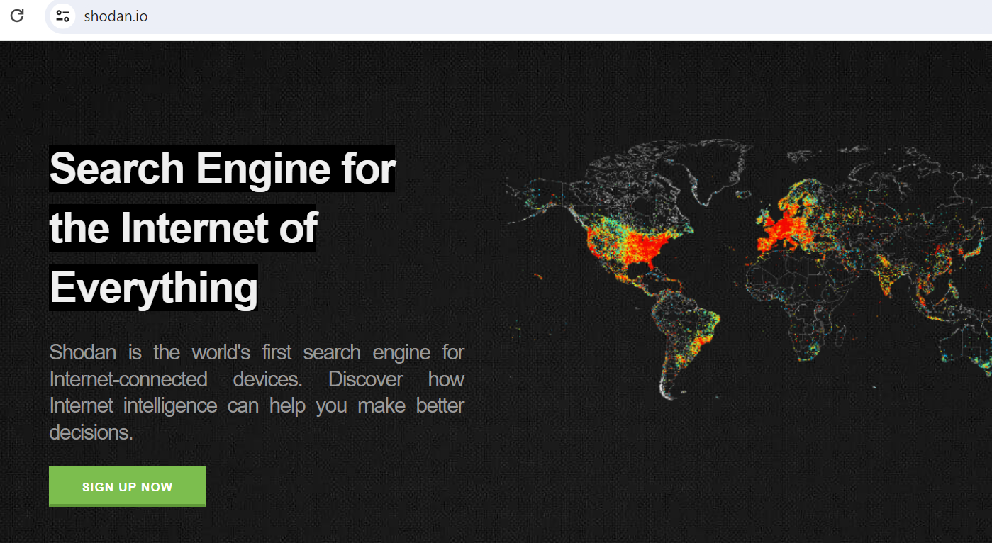
A first example - healthcare domain

Slide 5
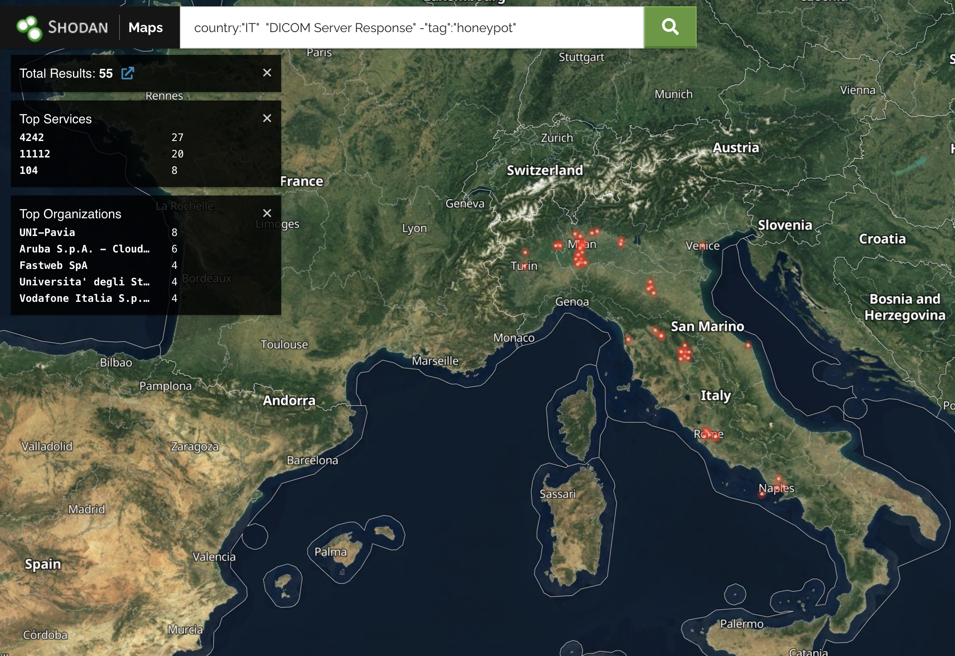
A few examples from our recent work
(our focus: healthcare domain)
🤔
DICOM → Digital Imaging and Communications in Medicine
PACS → Picture Archiving and Communication System

Slide 6

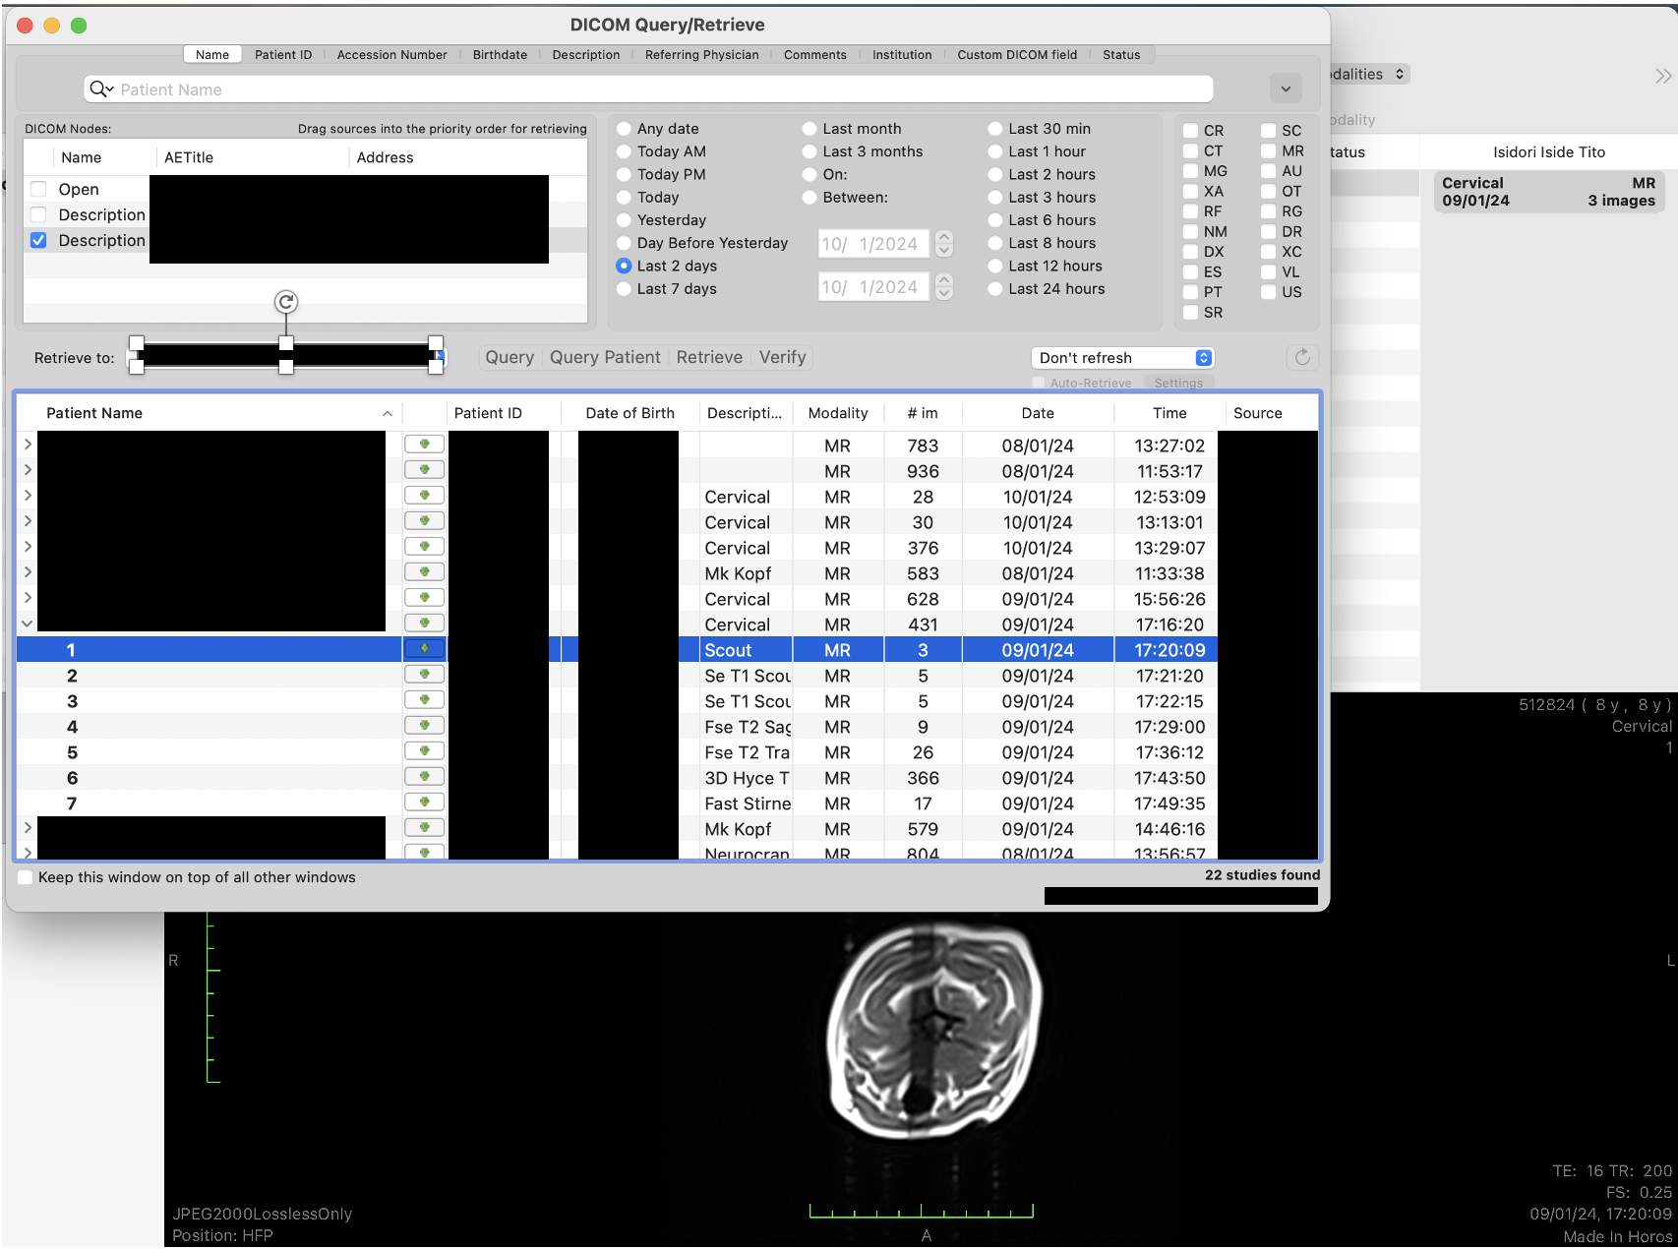

A few examples from our recent work
(our focus: healthcare domain)
What if some of such
exposed servers
were not protected?
🤔
DICOM → Digital Imaging and Communications in Medicine
PACS → Picture Archiving and Communication System
Attacker could access,
modify, and upload malware
(realistic example)

Slide 7
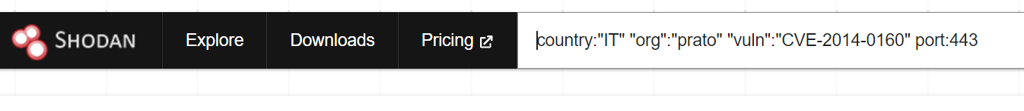
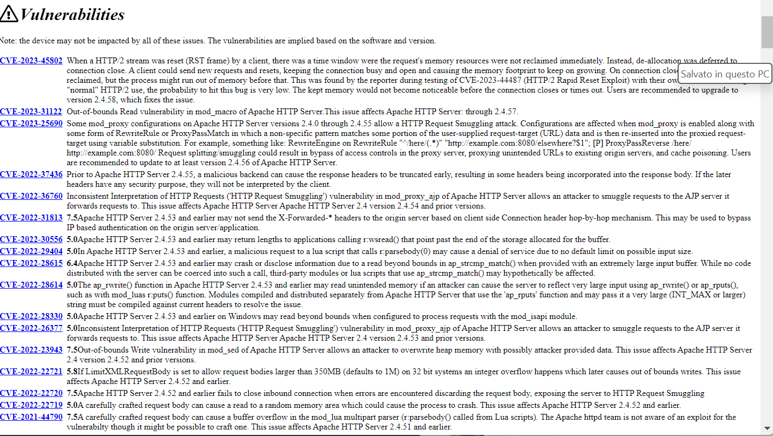
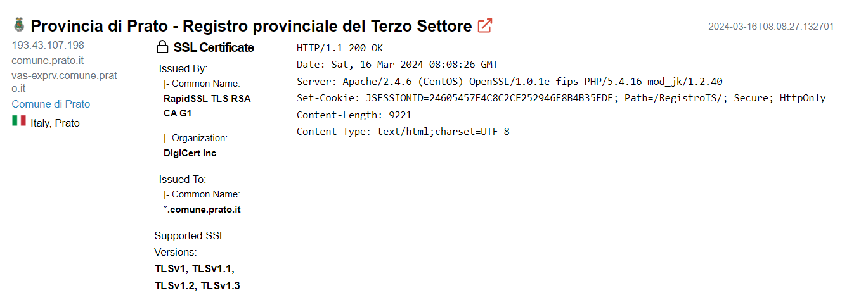

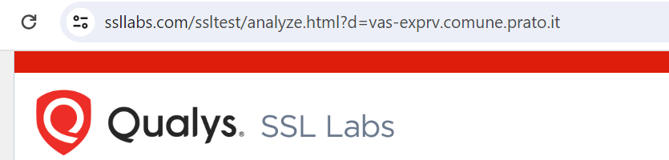
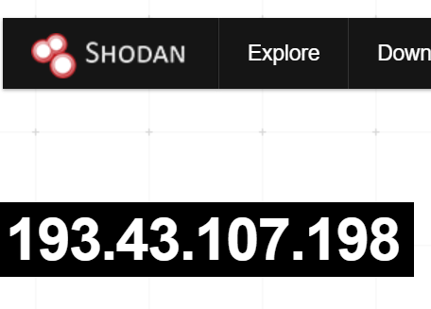
Another example… nearby here ☺
200+ other vuln.. lines deleted

Slide 8
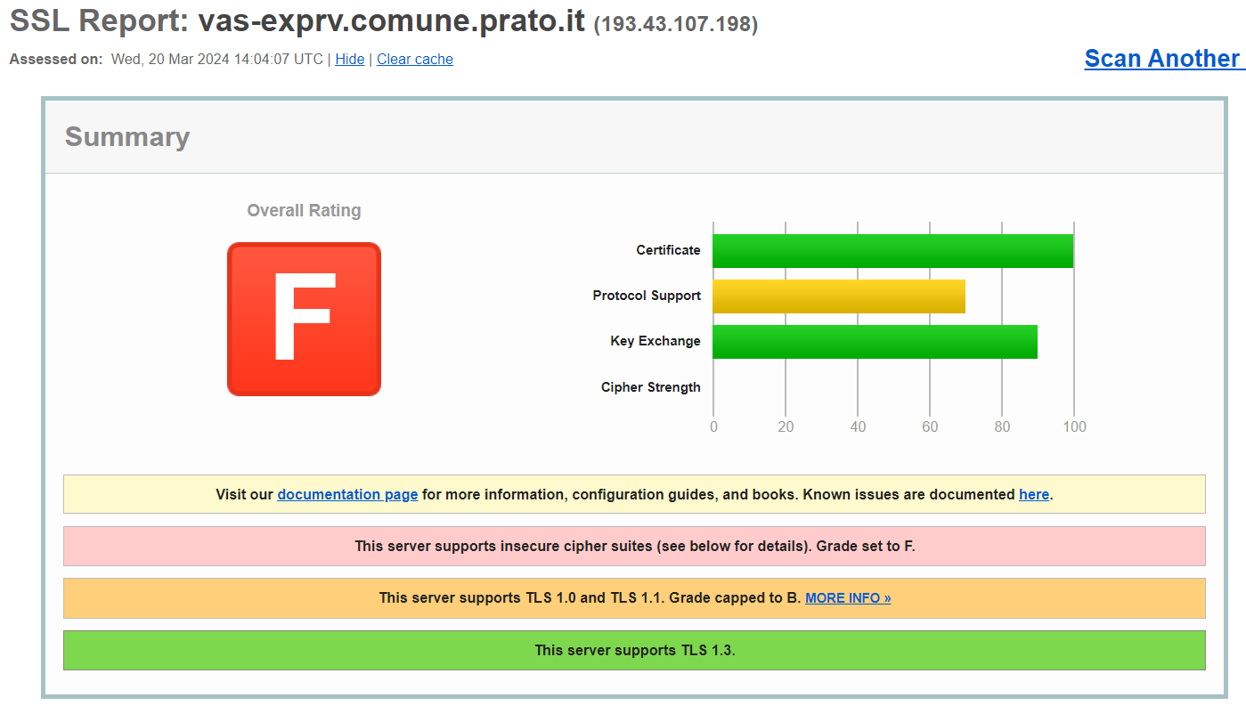
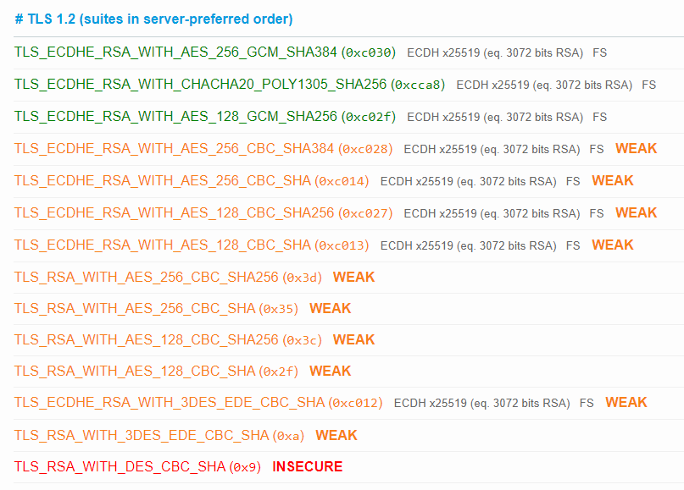
Another example… nearby here ☺

Slide 9
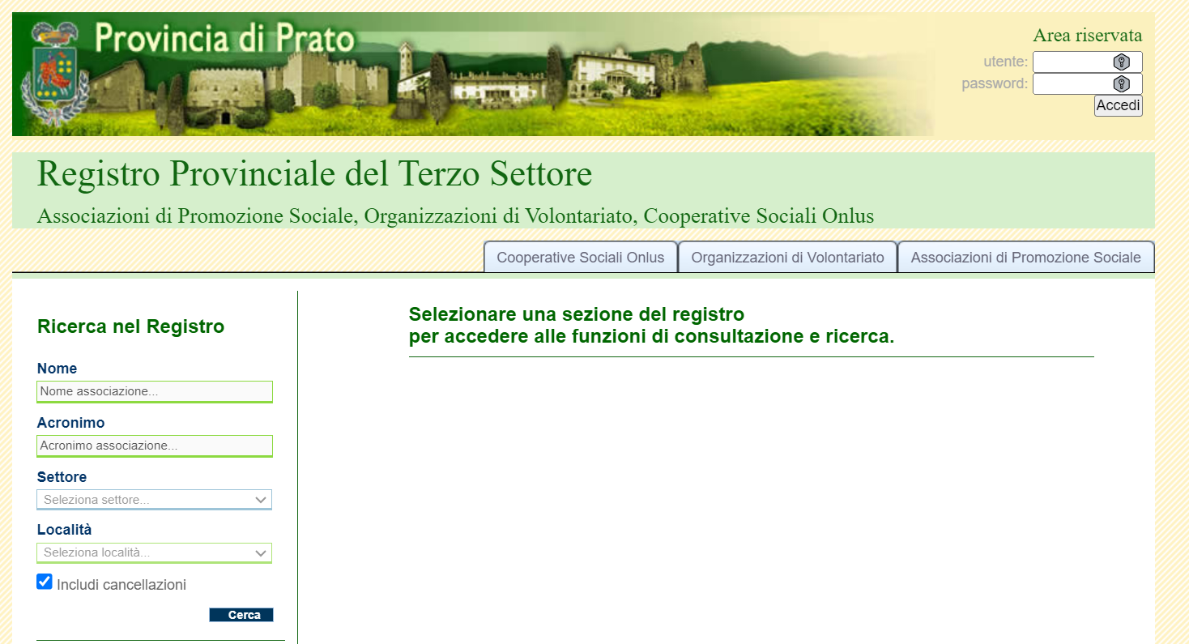
Upload forms: possible channels for
SQL injection, or for XSS storing?
We CANNOT check without permission
forbidden by law!

Slide 10
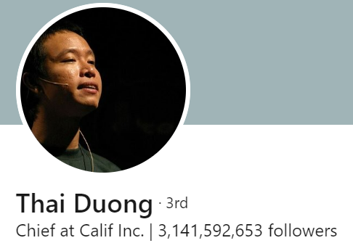
Hard-coded credentials hidden in plain sight
A perpetual issue: how to securely handle secrets in programs & apps
The (modern) survival guide to cybersecurity
Assume that your opponents know everything
If the source code or design blueprint were leaked today it should not change the security exposure of your product
(Quoting Thai Duong)
Plainly speaking:
Any practicioner can today reverse
so please DO NOT place secrets in plain sight within the code…

Slide 11
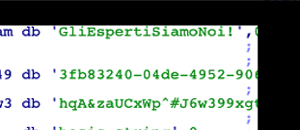
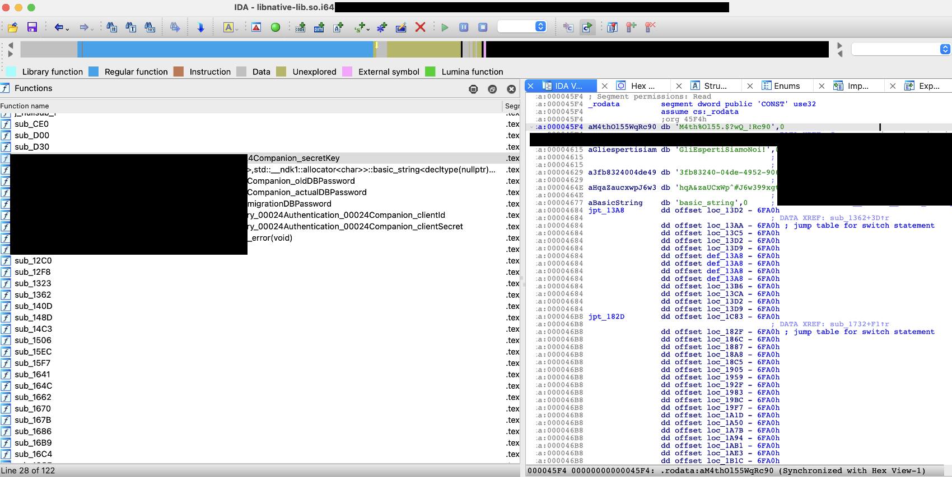
Hard-coded credentials hidden in plain sight
DITTO! Example from a (somewhat randomly chosen) medical device

Slide 12
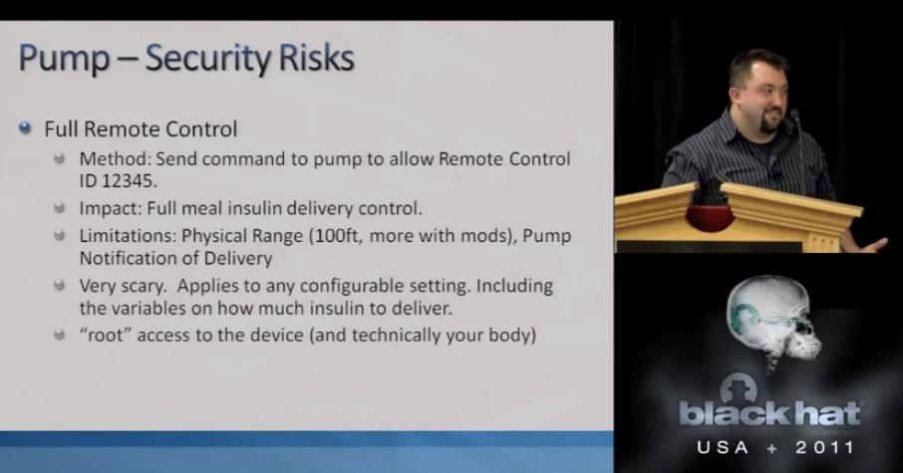
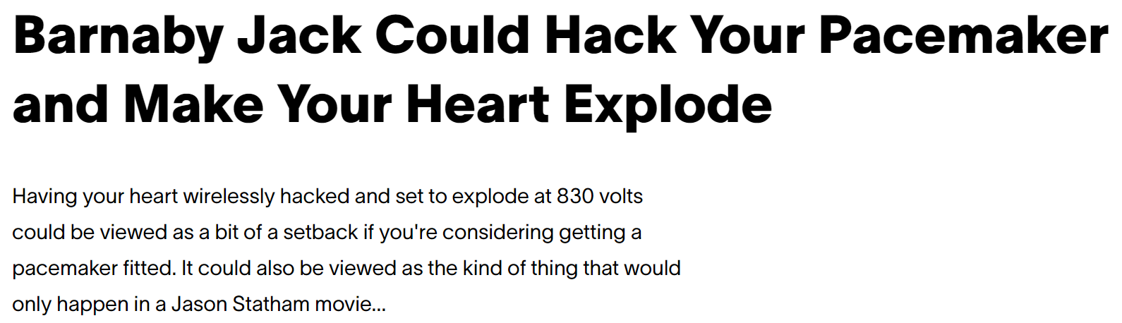
Access control bypass in medical devices: which potential impact?
Insulin pumps, Defibrillators, Pacemakers …. Inside our bodies and wireless connected!
Attacks demonstrated since 2011!!
Jay Radcliffe
Scheduled at Blackhat 2013
He died a week before…
Vice President Cheeney disabled pacemaker

Slide 13

So, what can we do?
Prevention is better than recovery!

Slide 14
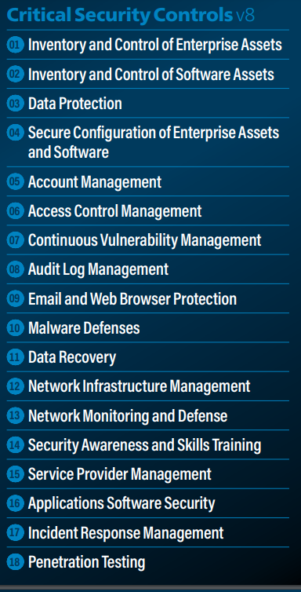
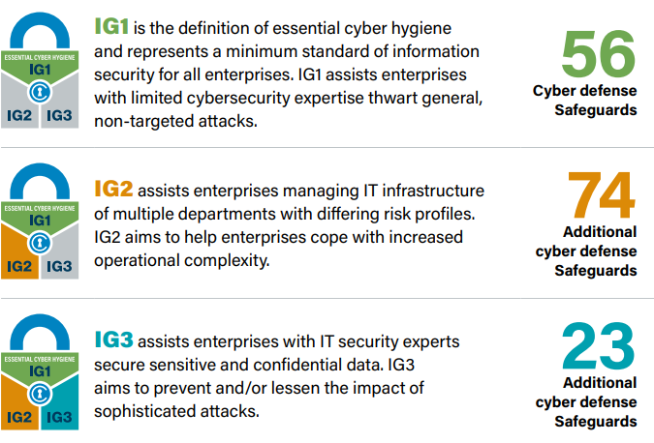
Control, control, use very pragmatic controls!
Don’t leave cyber doors badly opened!
Example: CIS Controls – very practical and «actionable»
tailored
to SMEs

Slide 15
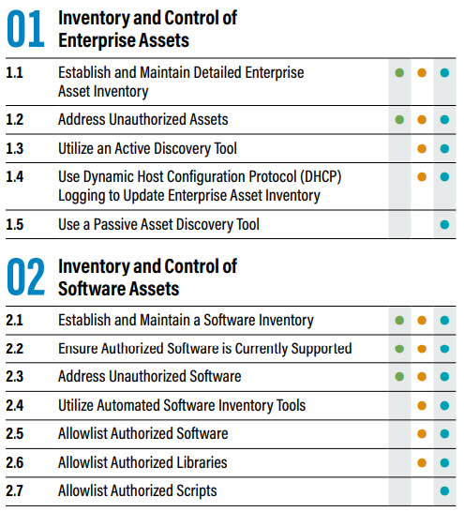
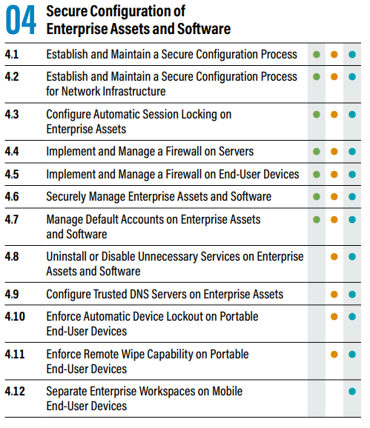
Control, control, use very pragmatic controls!
Don’t leave cyber doors badly opened!
Example: CIS Controls – very practical and «actionable»
tailored
to SMEs

Slide 16
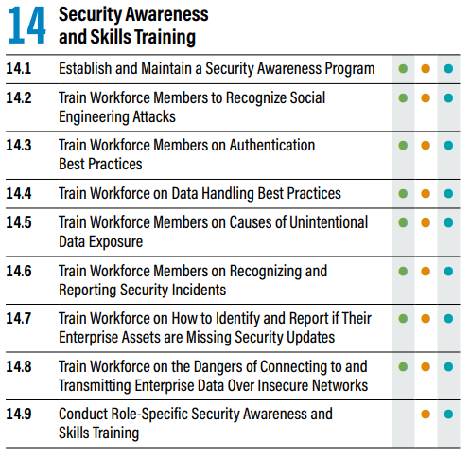
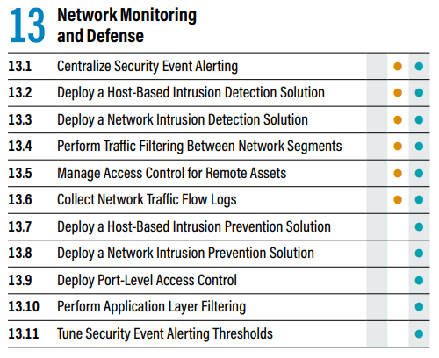
Cyber Threat Awareness → phishing resilience
One of the most important… «control»!
Compare with:

Slide 17
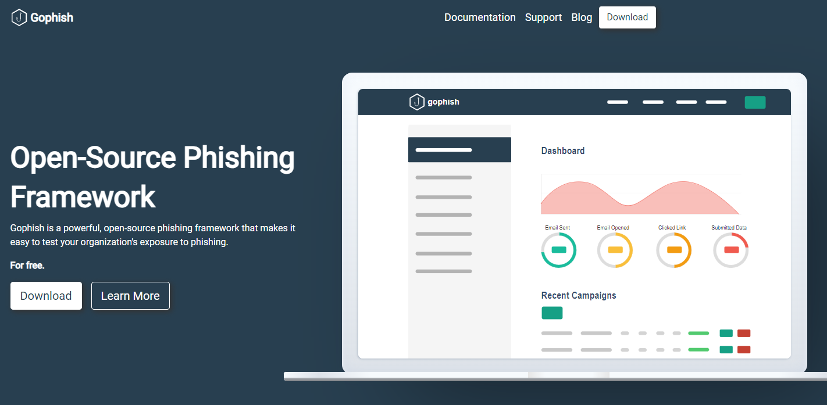
Cyber Threat Awareness → phishing resilience
and low-cost services and (even zero-cost!) solutions available

Slide 18







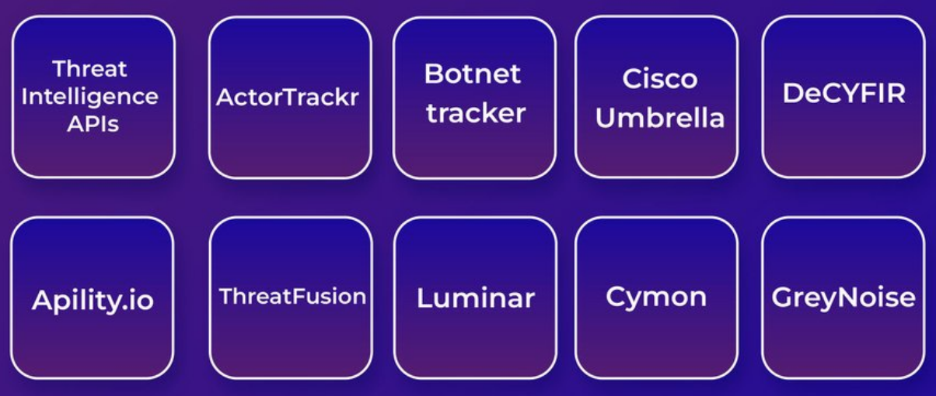












Institutions can SIGNIFICANTLY help… a) with centralized reconnaissance teams
Lower costs (better value for money)

Slide 19
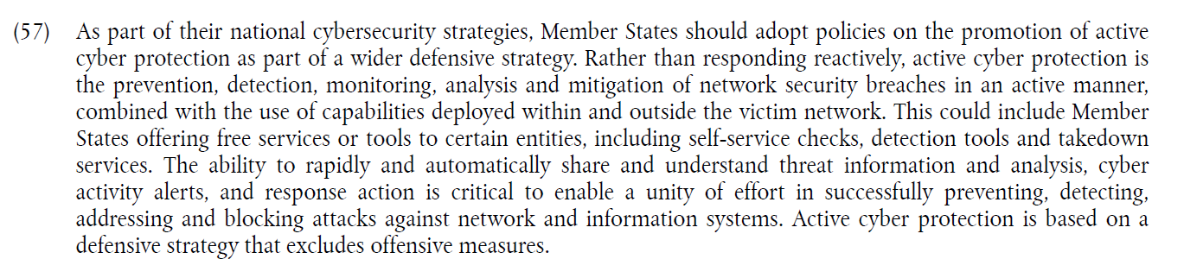



Institutions can SIGNIFICANTLY help…
b) by strengthening proactive/preventive support
Fix file upload check as follows… when done, let me check
Let’s redirect traffic to our WAF until the issue is cleared.
Your AWS buckets are unprotected, while you fix, use these presigned URLs. How-to instructions follow…
We obviously cannot recommend specific products, but this is a list of tools that can help you implement these recommended controls…
Guiding principles:
Support for prevention: also advocated by NIS2
Extensively assess patches (lack of skills → mistakes likely!)

Slide 20
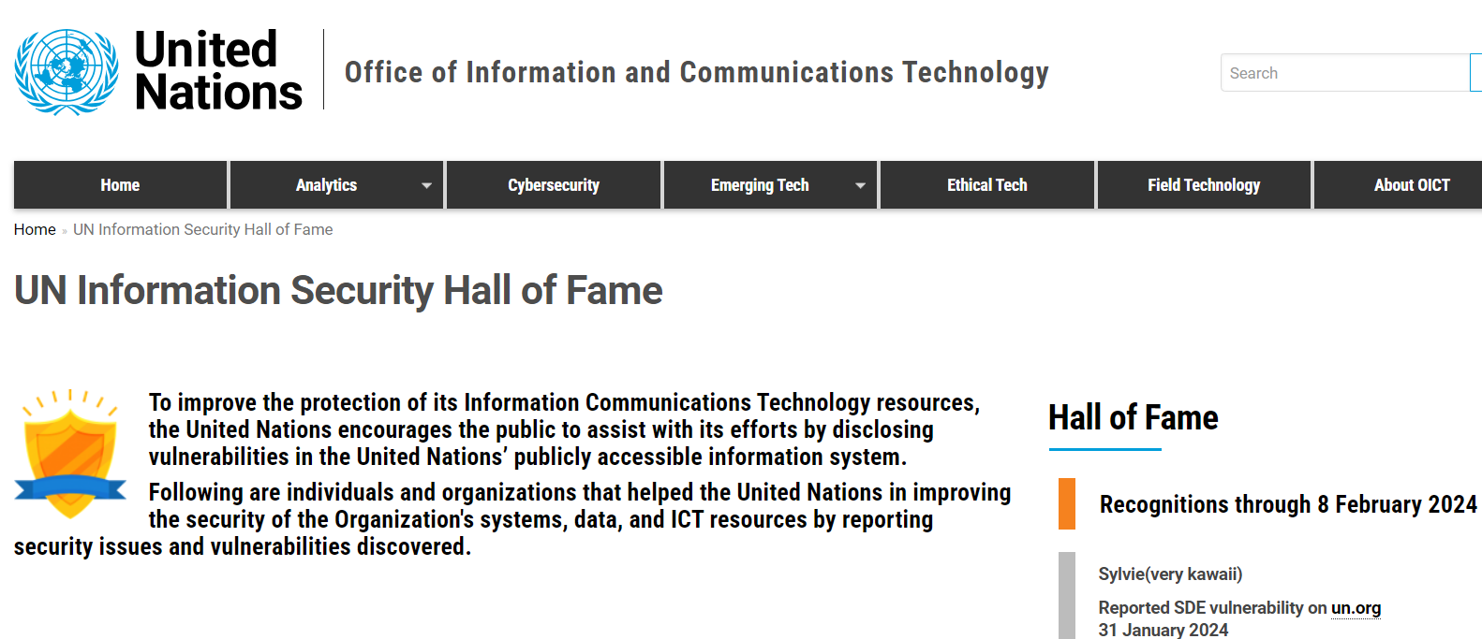
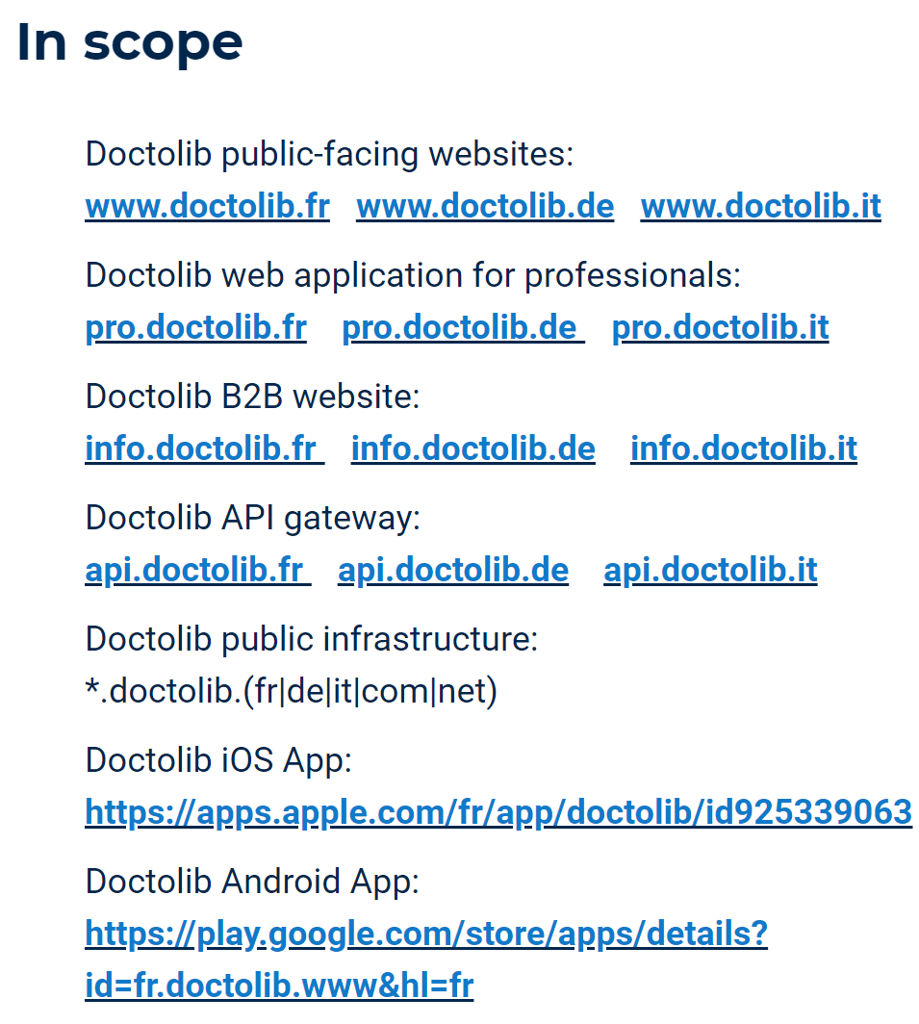
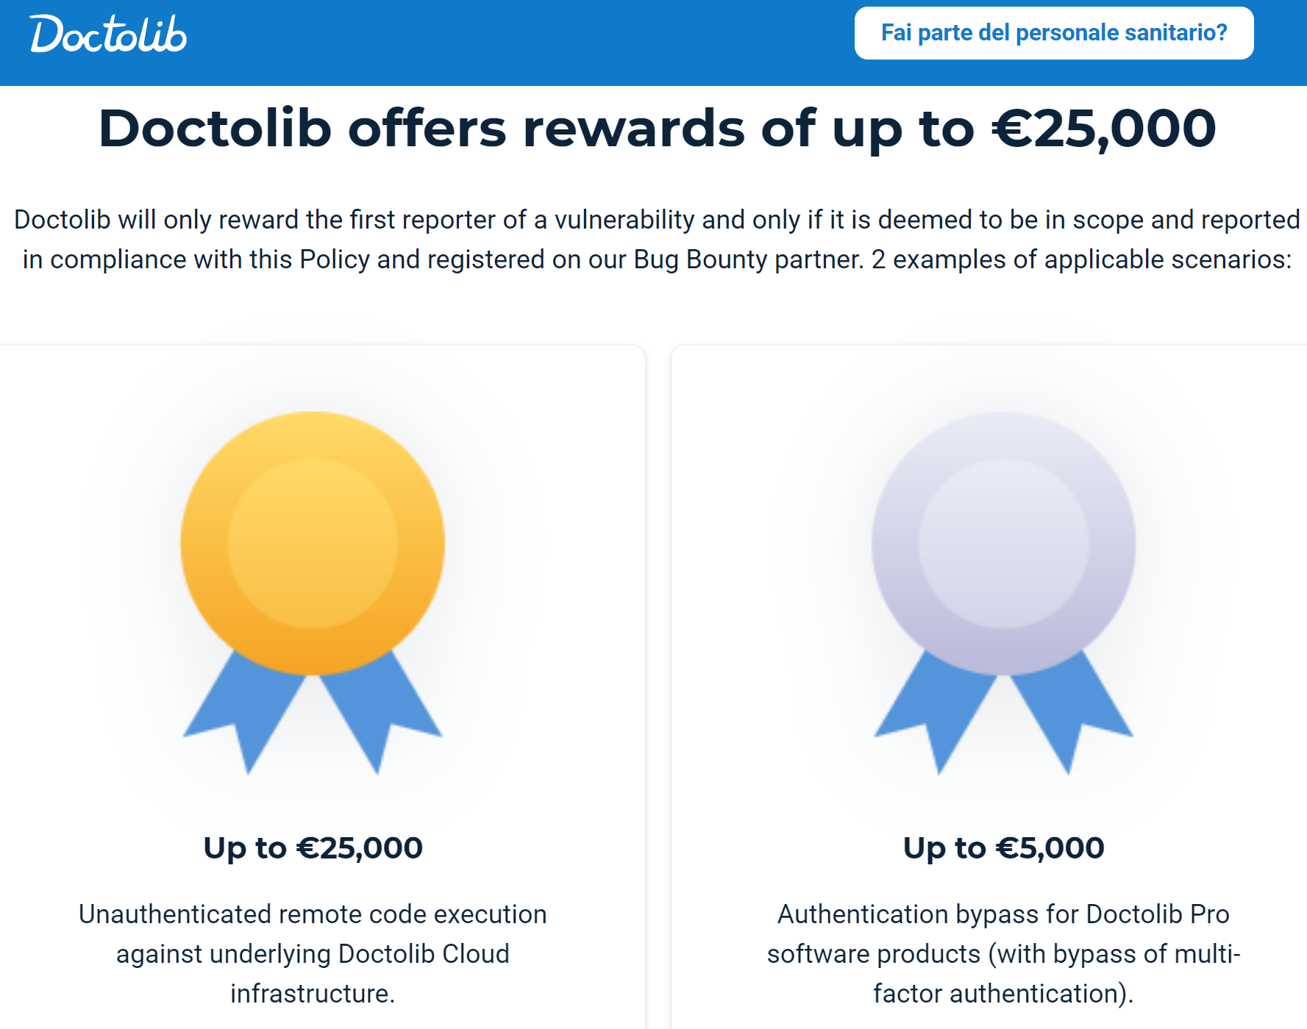
Institutions can SIGNIFICANTLY help…
c) by engaging security communities at large
Academies, ethical hackers, white hats, etc
Encourage massive public scrutiny
  Rather than opposing or punishing…
Bug bounty programs
  non necessarily money:
  social reward also VERY appealing!
If even very «critical» bodies do this, see e.g. US DoD’s
Hack-The-Pentagon;
Why shouldn’t we do the same?
What? Having THEM (!) attacking me???
YES! With:
  clear rules of engagement
  Structured processes for reporting vulnerabilities

Slide 21
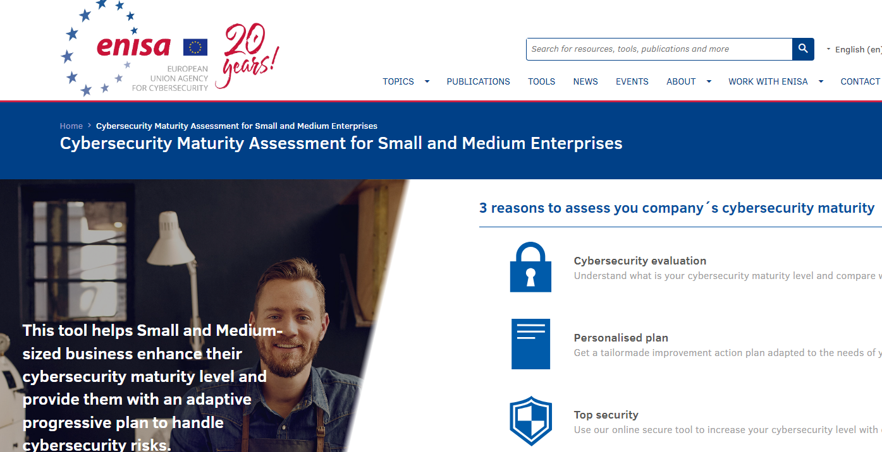
Conclusions
Ask yourself / your CEO (also) cybersecurity-related questions…
(Question #7 from ENISA’s Cybersecurity Maturity Assessment for SME)
What will be the level of impact on my business if:
Our accounting / financial data are totally lost
All our data are made unavailable for 1 month
Data of our core business is stolen and made available online and/or to our competitors
Confidential data of our customers has been stolen, the offenders threaten to publish them online and advertise our customers unless we pay a ransom
Our customer database is stolen and sold to our competitors

Slide 22


Conclusions
… And prioritize prevention / controls:
it’s in YOUR interest! And do it before others ☺
Who would you attack?
Crime do care only about money…
Weaker victims are preferable!

Slide 23
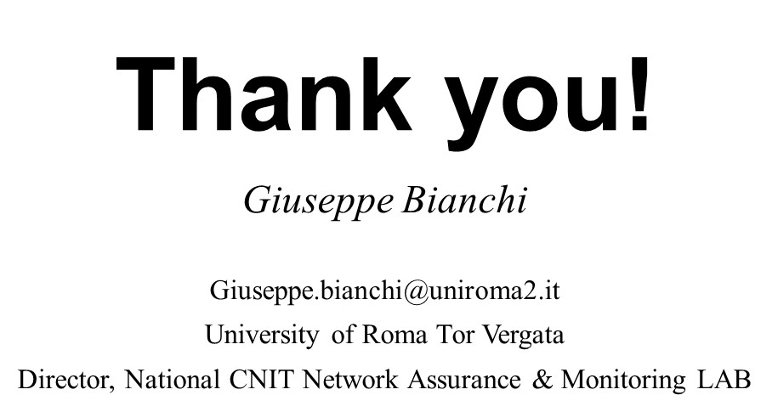
Conclusions
Prioritize prevention / controls:
it’s in YOUR interest! And do it before others ☺
Who would you attack?
Crime do care only about money…
Weaker victims are preferable!

