Slide 1
Cryptography, Quantum-safe Cryptography & Quantum Cryptography
Maurizio Dècina
CYBERDAYS, Prato, 21 marzo 2024
Regione Toscana

Slide 2
Topics
Today’s Cryptosystems on the Internet (asymmetric crypto: RSA, DH, ECC; symmetric crypto: AES, SHA)
Post Quantum Cryptography, 4 NIST Cryptosystem Candidates: Lattice, Code-based, Multivariate, and Isogeny-based,)
Quantum Key Distribution, quantum communications channels to transmit secure symmetric keys
Quantum Teleportation, transmission of information (qubits): no energy, matter or people tele transport
Quantum Cryptography, Future Cryptosystems based on Quantum Algorithms
Laboratory research developments

Slide 3
Public Key Cryptography
Message: P; Message Hash: SHA(P) Secure Hash Algorithm 256 bit
PKI, Public Key Infrastructure & Certification Authorities
A generates key pair: ${\text{K}}_{\text{A}}$& K_{A}⁻¹
A requests a certificate from $\text{Certification} \text{Autority} \text{(}\text{CA}\text{) }\text{for} \text{her} \text{public} \text{Key}$
A’s Digital Certificate signed by CA: A, ${\text{K}}_{\text{A}}$,{SHA(A, ${\text{K}}_{\text{A} }$)} K_{CA}⁻¹
A’s Digital Signature of message P: P,{SHA(P)} K_{A}⁻¹
A & B exchange their Certificates to know their Public Keys
A can send an encrypted message P to B
C= {P}$\text{K}\text{B}$; B decodes P= {C}K_{B}⁻¹
A sends a signed message P to B (or everybody who knows her public key)
C= P, {SHA(P)}K_{A}⁻¹; B decodes: P, {{SHA(P)} K_{A}⁻¹ }K_{A} = P, SHA(P)
Users acquainted with Algorithm, e.g. RSA
everybody knows
The CA’s public key

Slide 4
Internet Protocols & Security
Public Key Crypto
SSL/TLS
HTTP/HTTPS
SSH/IKE/Kerberos
SET
PGP
S/MIME
End User
Applications
Video
VoIP
Telnet
FTP
HTTP
SMTP
Application
SMTP
RTSP
RTP/RTCP
SIP
SSH
IKE
Kerberos
Network
Management &
Control
Applications
SNMP
DNS
DHCP
RIP
OSPF
RIP
OSPF
RSVP
BGP
UDP
TCP
SSL/TLS
PAT
Transport
MobileIP
IPSec
IGMP
IPv4
ICMP
NAT
Internet
IPv6
ICMPv6
ARP/RARP
All Internet Protocols
will soon include
Security
The red ones are
Security Protocols
SSL: Secure Socket Layer
TLS: Transport Layer Security
HTTPS: HyperTexT Protocol Secure
SSH: Secure Shell
PAP/CHAP
Data Link &
Physical
Data Link
IEEE 802, PPP
Physical Layer
Twisted Pairs, Coax, Fiber, Radio, Powerline, ..
Source: M. Dècina, 2003

Slide 5
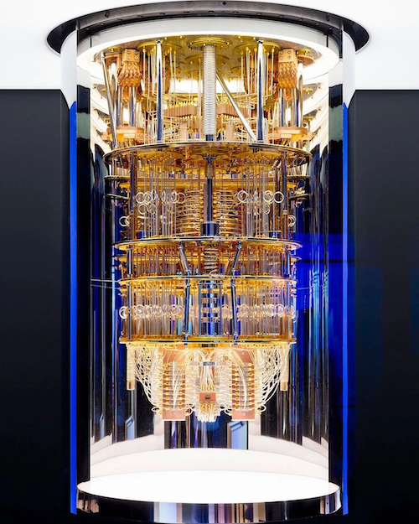
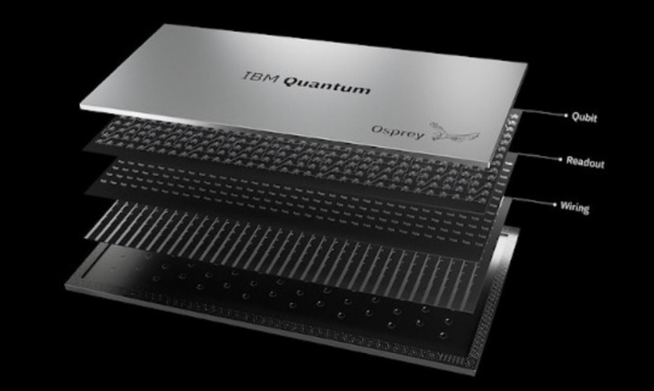
Quantum Computing
Quantum Computing
Classic Computing
Calculates with qubits, which can represent 0 and 1 at the same time
Calculates with transistors, which can represent either 0 or 1
Power increases exponentially in proportion to the number of qubits
Power increases in a 1:1 relationship with the number of transistors
Quantum Computing
Quantum computers have high error rates and need to be kept ultracold
Classical computers have low error rates and can operate at room temp
IBM 127 Qubit Eagle Computer, 2021
Well suited for tasks like optimization problems, data analysis, and simulations
Most everyday processing is best handled by classical computers
IBM 433 Qubit Ospray Computer, 2022

Slide 6
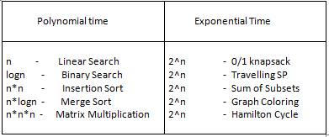
Computational Complexity Theory
Where BQP lives in the world of complexity classes
NP
NP- Complete
NP-Hard
P
P = Polynomial time Problems
NP: Non-deterministic Polynomial time Problems
Bounded-error Quantum Polynomial time (BQP)
Quantum Algorithms can be based on Phase Estimation: including Shor’s algorithm, on Amplitude Amplification including Grover’s algorithm, and on Quantum Walks
Factorial Time - n! - Error Correcting Code

Slide 7
Quantum Cyber Threats to Encryption
There are two types of encryption systems currently in use: symmetric and asymmetric encryption (which is also known as public key cryptography).
Quantum Computing poses a real threat to systems leveraging asymmetric encryption
“Shor’s algorithm”, which runs on a quantum computer, efficiently solves the integer factorization problem that offers the foundations of the public-key cryptography.
This implies that, if a quantum computer is developed, today’s public-key cryptography algorithms (e.g., RSA, ECDH: Elliptic Curve Diffie Hellman Key Exchange) and protocols would need to be replaced by algorithms and protocols that can offer cryptanalytic resistance against
Symmetric cryptography is also affected by Quantum Computing, but significantly less
No quantum computer is known to break the security properties of these classes of algorithms, however performing a “Grover’s Search” using a quantum computer halves their security level.
This means that breaking AES-128 takes 264 quantum operations, while current attacks take 2128 steps.
While this is a change, it can be managed quite easily by doubling the key sizes, e.g., by deploying AES-256
Examples of public-key cryptography algorithms:
RSA, Diffie-Hellman and Elliptic Curve Cryptography
Examples of symmetric cryptography algorithms:
AES and HMAC-SHA2

Slide 8
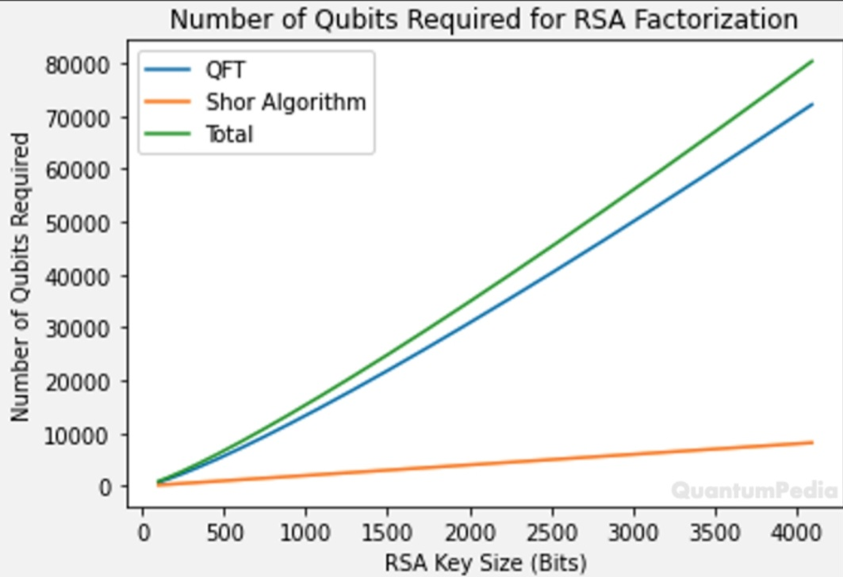
Qubits required for RSA Factorization
QFT: Quantum Fourier Transform
Source: MR. Asif, 2021
Source: QuantumPedia, 2021,

Slide 9
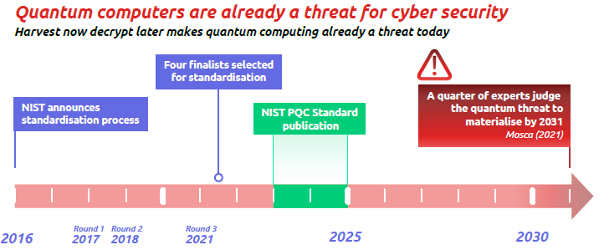
Quantum Threats to Financial Data
NIST - National Institute of Standards and Technology
While current quantum computers do not pose any threat, data stored or transmitted today are exposed to “harvest now, decrypt later” attacks by a future quantum computer.
The long-term sensitivity of financial data means that the potential future existence of a quantum computer effectively renders today’s systems insecure.
https://www.netmeister.org/blog/pqc-2024-01.html
https://www.ibm.com/quantum/blog/ibm-quantum-roadmap

Slide 10
Four NIST PQC Standard Algorithms
CRYSTALS-Kyber: This algorithm is designed for generating encryption keys, and for creating secure transactions on the Internet. It's part of the CRYSTALS (Cryptographic Suite for Algebraic Lattices) package, which is based on the hardness of certain problems in lattice-based cryptography
CRYSTALS-Dilithium: This is another part of the CRYSTALS package and is designed to protect the digital signatures we use when signing documents remotely. Digital signatures are a crucial part of ensuring the integrity and authenticity of digital documents
SPHINCS+: This is a stateless hash-based signature scheme, also designed for digital signatures. Hash-based signatures are particularly interesting because they're resistant to quantum attacks, making them a good choice for post-quantum cryptography
FALCON: This stands for Fast-Fourier Lattice-based Compact Signatures over NTRU. Like the others, it's also designed for digital signatures. A draft standard for FALCON will be released in about a year, which will provide more details about its implementation
Source: NIST 2023

Slide 11
Key Encapsulation Mechanism for PQC
KEM Algorithm | Generate Key | Encapsulation | Decapsulations | Public Key Size | Encapsulation Size
NTRU (lattice-based PQC) | 0.048ms | 0.0073ms | 0.012ms | 699B | 699B
Kyber (lattice-based PQC) | 0.0070ms | 0.011ms | 0.0084ms | 800B | 768B
SABER (lattice-based PQC) | 0.012ms | 0.016ms | 0.016ms | 672B | 736B
Classic McEliece (code-based PQC) | 14ms | 0.011ms | 0.036ms | 261120B | 128B
SIKE (isogeny-based PQC) | 3.0ms | 4.4ms | 3.3ms | 197B | 236B
ECDH (X25519) (non-PQC) | 0.038ms | 0.044ms | 0.044ms | 32B | 32B
ECDH (P-256) (non-PQC) | 0.074ms | 0.18ms | 0.18ms | 32B | 32B
RSA-3072 (non-PQC) | 400ms | 0.027ms | 2.6ms | 384B | 384B
CRACKED
ECDH: Elliptic Curve Diffie Hellman Key Exchange
Source: Ericsson Review, 2021

Slide 12
Increase of Key & Ciphertext/Signature Sizes
Non-PQC
PQC
Non-PQC
PQC
Non-PQC
PQC
Non-PQC
PQC
Bytes
Bytes
Source: https://www.telsy.com/la-crittografia-post-quantum-pqc-una-soluzione-classica-alla-minaccia-quantistica/

Slide 13
Photonic Quantum Key Distribution
100 Gbit/s line speed data encryption. 10 km fiber distance. Long-term continuous operation of the quantum secured communication system (BB84), using feedback control, decoy and error correction
Source: Toshiba, Nature, 2021

Slide 14
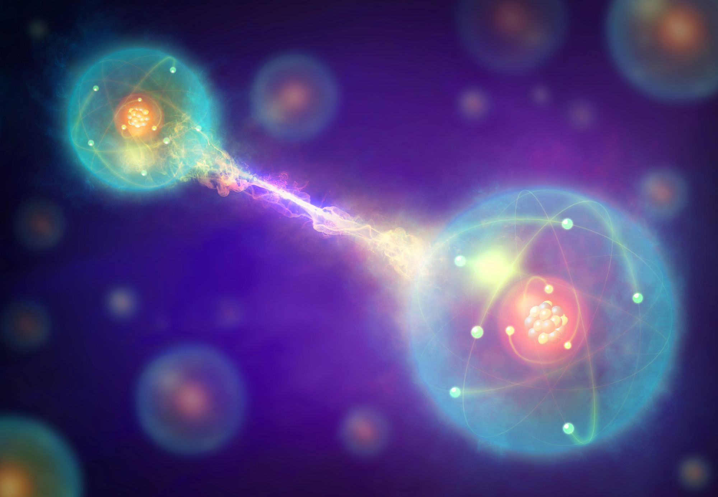
Quantum Entanglement & Teleportation
Quantum teleportation enables the ‘‘transmission’’ of an unknown qubit without the physical transfer of the particle encoding the information
It requires three main ingredients:
both source and destination share the same pair of entangled qubits (a quantum communication channel is needed to distribute such a pair)
local quantum circuit operations both at the source and the destination
c) the transmission of two classical bits from source to destination via a conventional communication channel
Quantum Teleportation refers to transmission of information, not energy, matter or people!
“Spooky action at a distance”
Albert Einstein, 1935
Entangled Qubits

Slide 15
5 Issues on Quantum Key Distribution - Some Highlights
QKD is only a partial solution. QKD generates keying material for an encryption algorithm that provides confidentiality. QKD does not provide a means to authenticate the QKD transmission source. Source authentication requires the use of asymmetric cryptography or preplaced keys
QKD requires special purpose equipment. It cannot be implemented in software or as a service on a network and cannot be easily integrated into existing network equipment. Since QKD is hardware-based it also lacks flexibility for upgrades or security patches
3. QKD increases infrastructure costs and insider threat risks
Securing and validating QKD is a significant challenge. The actual security provided by a QKD system is not the theoretical unconditional security from the laws of physics, but rather the more limited security that can be achieved by hardware and engineering designs. The tolerance for error in cryptographic security is many orders of magnitude smaller than in most physical engineering scenarios. The specific hardware used to perform QKD can introduce vulnerabilities
5. QKD increases the risk of denial of service. The sensitivity to an eavesdropper as the theoretical basis for QKD security claims also shows that denial of service is a significant risk for QKD

Slide 16
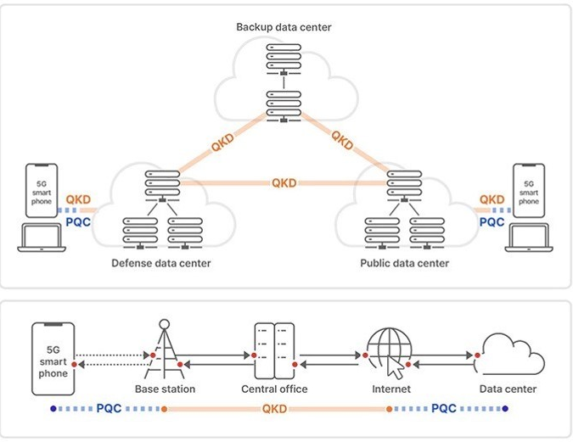
SK Telecom’s QKD & PQC Networking
Source: SK Telecom, 2022
Trunking Fibers
RSA, ECDH, DSA…
CRYSTALS, SPHINX+,
FALCON…
BB84
K
QKD Fiber
ROUTER

Slide 17
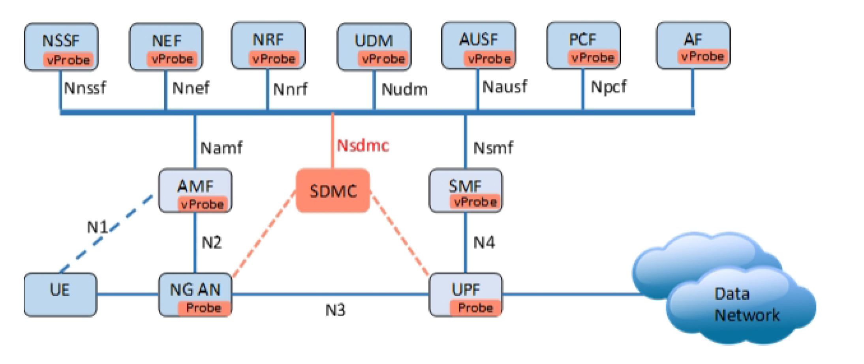
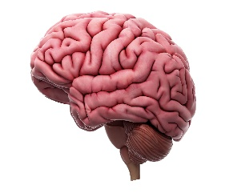
5G/6G Evolved Security Model
Visibility
Software Defined (Security) Monitoring, SDM
Centralized Security Policy =
AI Security as a Service
R- Kahn et alii, IEEE Communications Surveys and Tutorials, 2019

