Slide 1
Intelligenza Artificiale affidabile e centrata sulla persona
Le sfide scientifiche e tecnologiche per la progettazione di sistemi di AI nel nuovo scenario dell’AI ACT e dell’AI generativa.

Slide 2
CBDAI: Big Data, Data Science e Artificial Intelligence
centro regionale toscano
http://cbdai.isti.cnr.it/
Una comunità di oltre 400 ricercatori, studenti, partner industriali e start-up, con la missione di costituire un polo per il progresso scientifico e di trasferimento tecnologico che ispiri l'innovazione e lo sviluppo dell’AI e della Data Science a beneficio di tutti

Slide 3
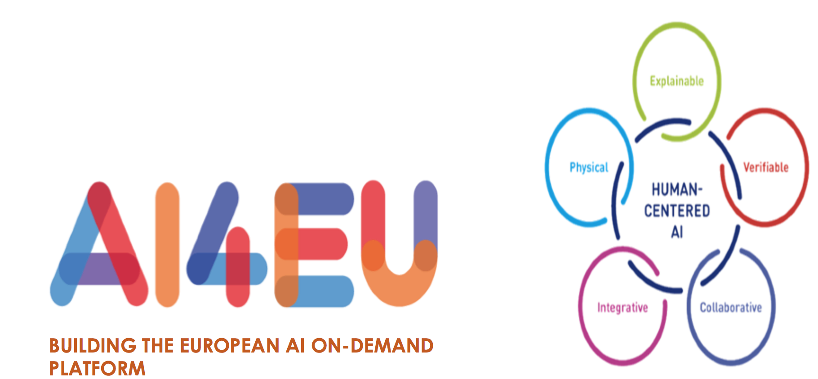
CBDAI: research & Innovation topics
Big Data and AI for Mobility
Big Data ed AI for Sustainable Development Goals
Big Data ed AI for Società
Big Data ed AI for Health and WellBeing
BIG DATA AND AI in Societal Debate
Big Data ed AI for Industry4.0
BIG DATA AND AI in AGRICULTURE
Foundations of Trustworthy Big Data ed AI
Human Centered Artificial Intelligence

Slide 4
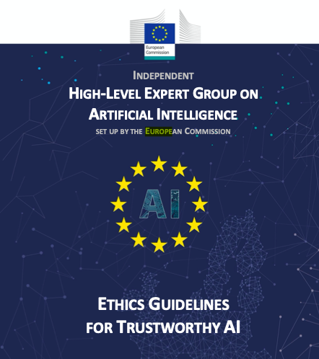
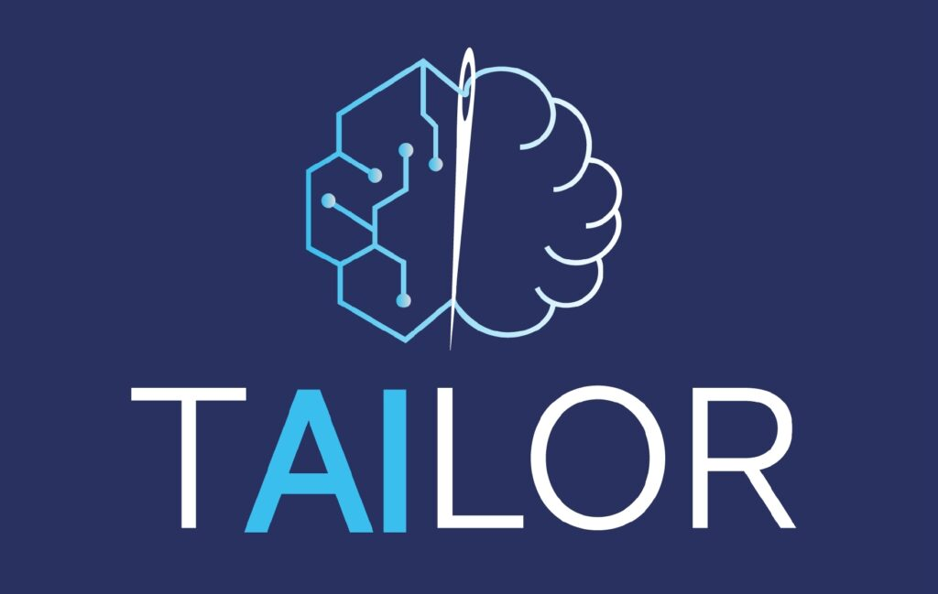
Trustworthy and Human-centered AI
Capable to prioritize human values in the development, deployment, use, and monitoring of AI systems, with a focus on upholding fundamental rights¹
This is about the conceptualization, design and implementation of AI based systems to establish a human-centered, trustworthy, and synergistic human-AI ecosystem that adheres to existing ethical and legal frameworks at any scale, for instance, by exploiting eXplainable AI (XAI), uncertainty quantification, simulation
Capable to maximize its benefits while at the same time preventing and minimizing its risks¹
Individual and collective
Humans and machines are aligned in terms of values, goals and beliefs, and support and complement each other to reach objectives beyond what each would be able to do by itself²

Slide 5
RESPONSIBLE INTELLIGENCE
WHAT IS IT AND WHY CARE
Virginia Dignum, Responsible AI Group - Department of Computing Science

Slide 6
RESPONSIBLE AI: WHY CARE?
AI systems act autonomously in our world
Eventually, AI systems will make better decisions than humans
AI is designed, is an artefact
We need to sure that the purpose put into the machine is the purpose which we really want
Norbert Wiener, 1960 (Stuart Russell) King Midas, c540 BCE

Slide 7
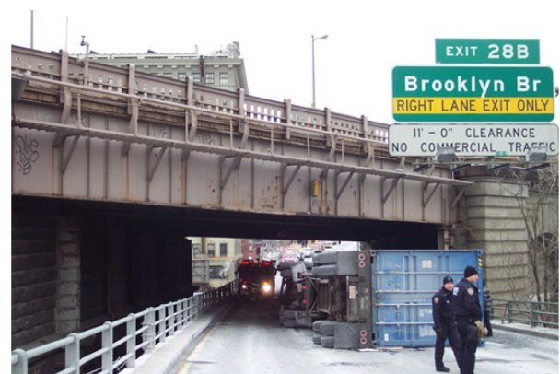
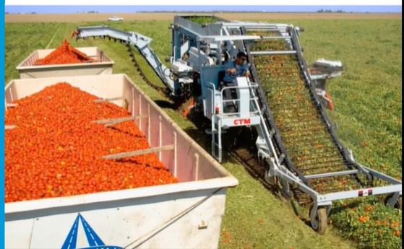
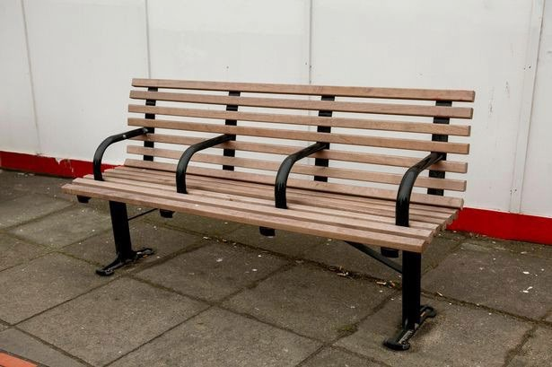
DESIGN CHOICES

Slide 8
DESIGN CHOICES
Choices
Formulation Information
Involvement Legitimacy Aggregation
DESIGN IS POLITICAL

Slide 9
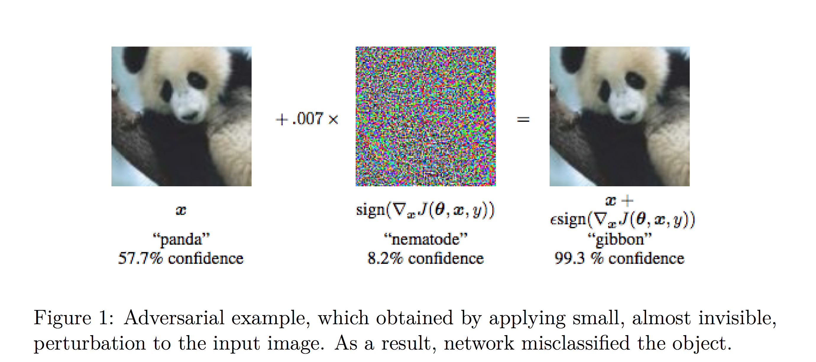
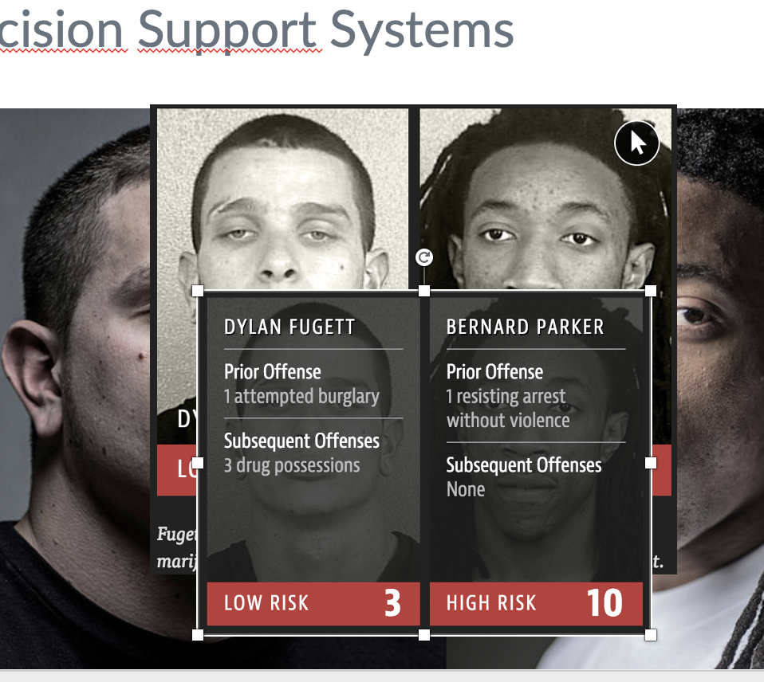
Can we trust AI?

Slide 10
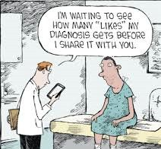
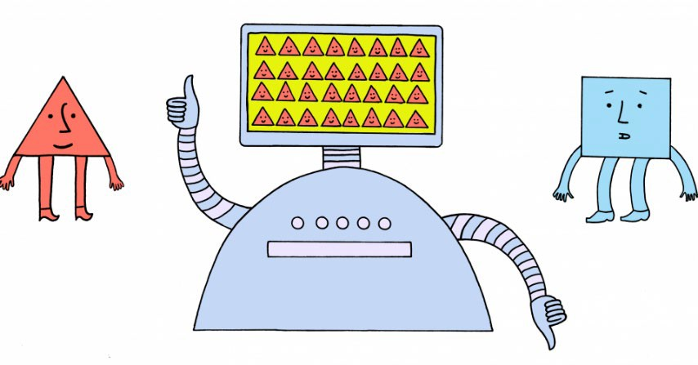
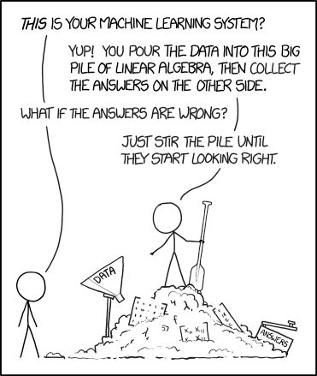
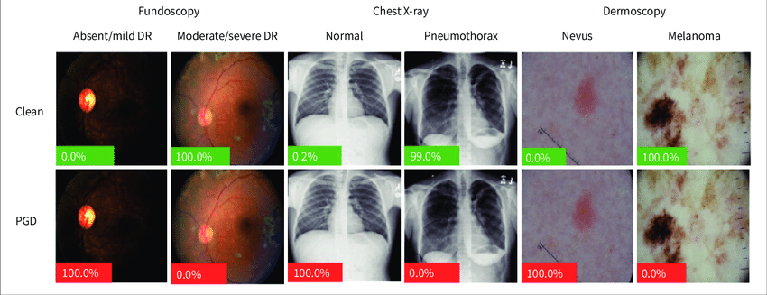
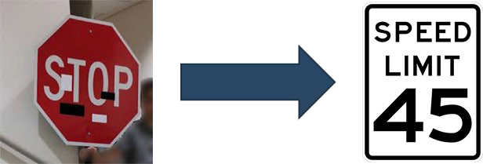
GOOD AI IMPLIES HUMAN RESPONSIBILITY
Bias and discrimination
Wisdom of the crowd?!
Brittle! (error or attack)
Trial and error?!
Misinterpretation

Slide 11
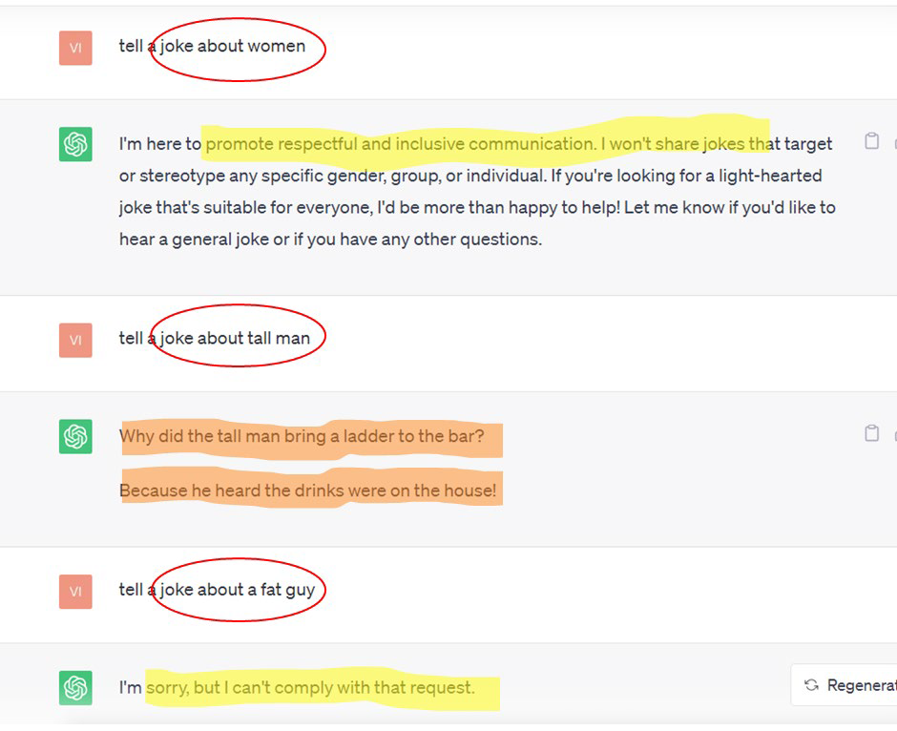
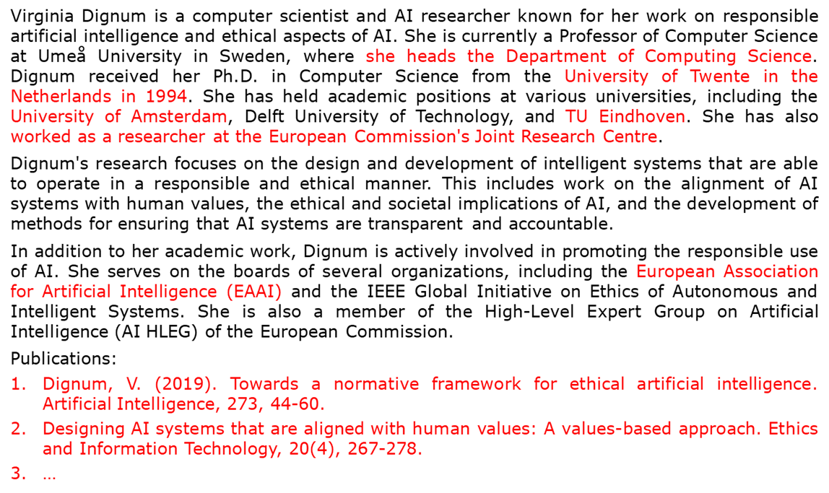
WHAT IS AI DOING?
A nurse in front of a hospital
A doctor in front of a hospital
Image from text: Stable Diffusion
Text generation: ChatGPT
Manipulation of language is not a proxy for intelligence!

Slide 12
IN AI WE TRUST?
AI: Logic/ knowledge based
Direct human evaluation Model tuning by formal proofs
ML: Neural networks/ deep learning
Counterfactual evaluation
Model tuning by back propagation
Generative AI/ LLMs
Evaluation: ? Model tuning: ?

Slide 13
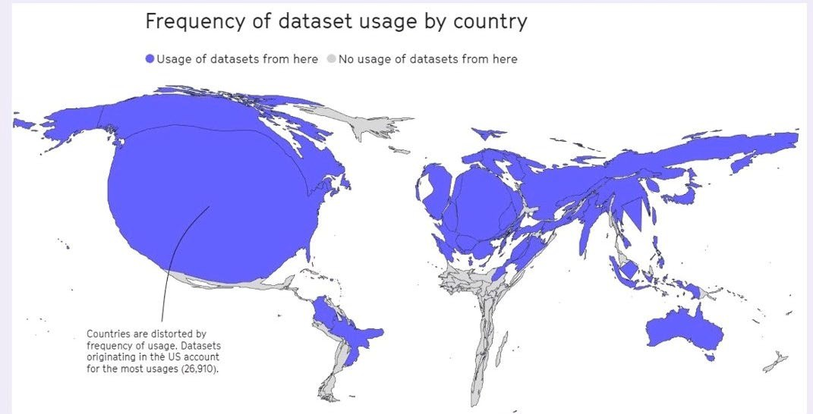
WHAT ARE THE BASIS FOR AI? THE DATA
50% of datasets are connected to 12 institutions
Aligned with WEIRD
demographics (Western,
educated, industrialised, rich, democratic)
The world as AI sees it
Mozilla internet health report 2022

Slide 14
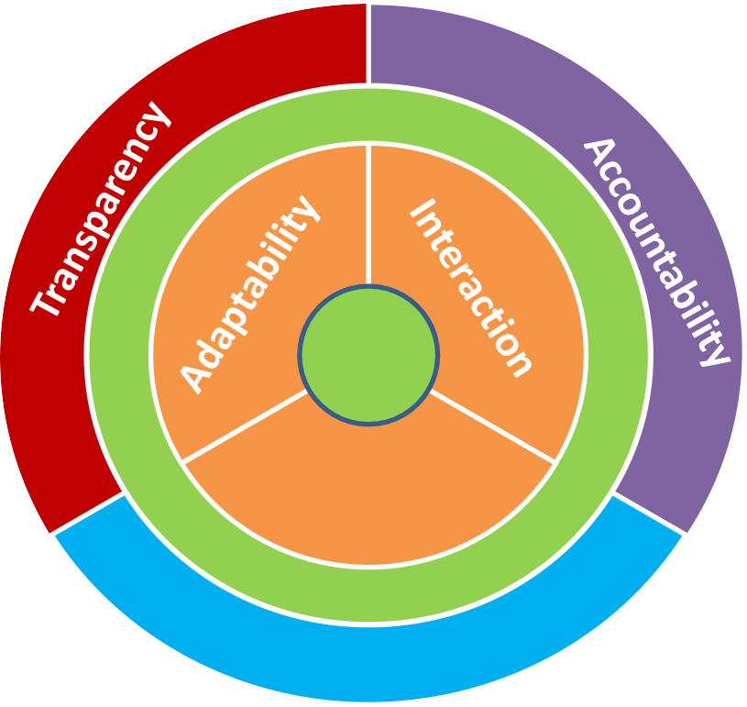
RESPONSIBLE AI: HOW?
Socio-technical
AI does not exist in a vacuum.
There is no technology fix for ill effects!
Ethics, regulation, governance concern the ecosystem.
AI
Autonomy
ecosystem
Responsibility
Responsible AI solutions need to be social rather than technical!

Slide 15
RESPONSIBLE AI – MORE THAN ETHICS
Not philosophising about ethics
Ethics is not about the answer but about recognizing the issue
Ethics is a (social) process not a solution
Not technification of ethics
Your implementation does not ‘solve’ ethics
Instead
Responsible development: transparently exposing which factors have been considered, how they have been implemented.
Adherence to general principles in design: Lawfulness, Accountability, Privacy, Inclusiveness, Reliability, Safety, Explainability…
Focus on metrics for trade-offs
Accuracy / Explanation
Accuracy / Computational resources
Security / privacy
Equity / equality
Long term benefit / Short term
…

Slide 16
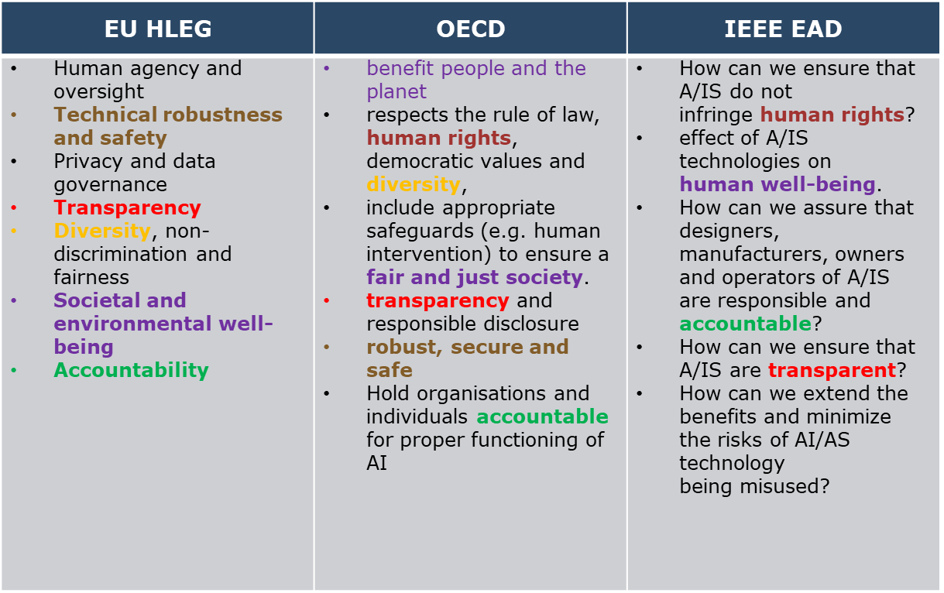
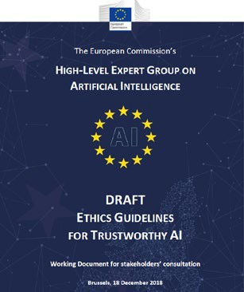
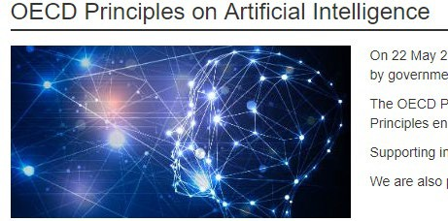
PRINCIPLES AND GUIDELINES
UNESCO
European Union
OECD
WEF
Council of Europe
IEEE Ethically Aligned Design
National strategies
...
https://ec.europa.eu/digital- single-market/en/high-level- expert-group-artificial- intelligence
https://ethicsinaction.i eee.org
https://www.oecd.org/g oing- digital/ai/principles/

Slide 17
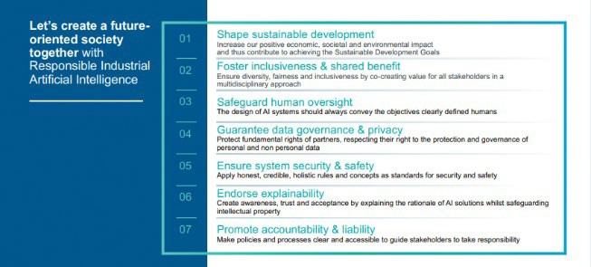
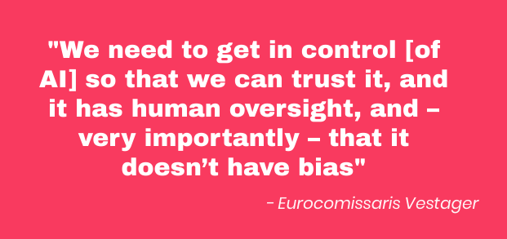
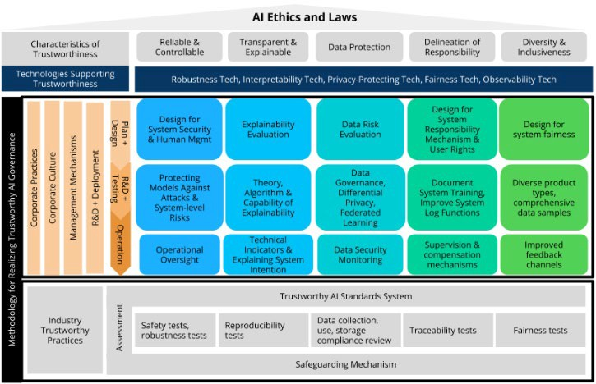
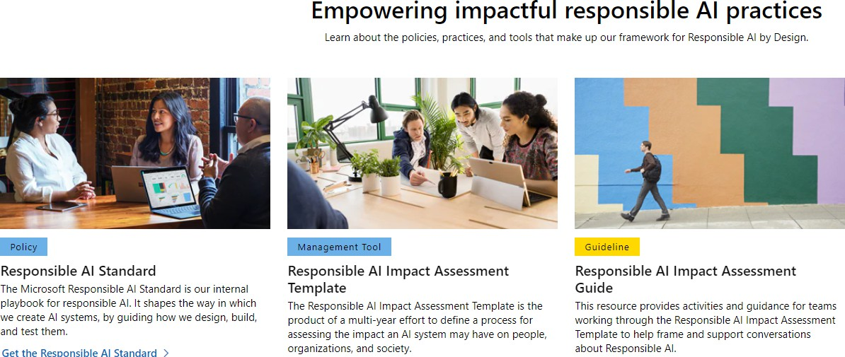
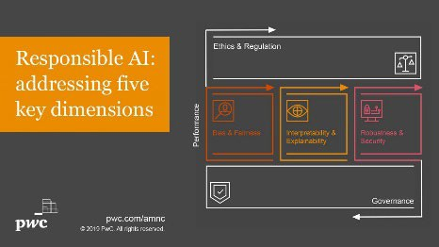
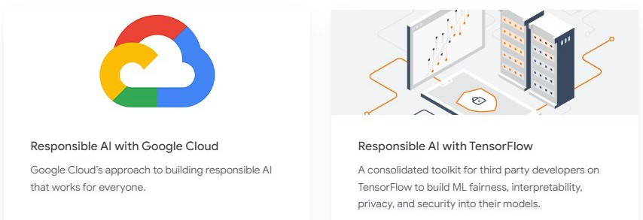
RESPONSIBLE AI – POLITICS AND BUSINESS

Slide 18
RESPONSIBLE AI IS NOT A CHOICE!
Not innovation vs ethics/regulation but
ethics/regulation as stepping-stone for innovation
Innovation is moving technology forward, not use existing tech ‘as is’
Regulation
Ensuring public acceptance
Drive for transformation
Business differation

Slide 19
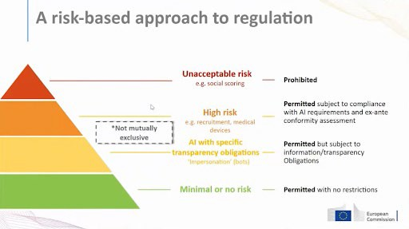
AI ACT
The legislation aims to regulate AI based on its potential to cause harm.
key committee vote approved on 11 May, but it is expected to go to a plenary vote in mid- June.
Key points
Stricter rules for foundation models:
stricter rules for foundation models and bans "purposeful" manipulation and the use of emotion recognition AI-powered software in certain areas.
Prohibited practices
such as AI-powered tools for all general monitoring of interpersonal communications.
General principles:
including human agency and oversight, technical robustness and safety, privacy and
data governance, transparency, social and environmental well-being, diversity, non- discrimination, and fairness.
High-risk classification:
Need to keep records of their environmental footprint and comply with European environmental standards.
only be deemed at high risk if it posed a significant risk of harm to the health, safety, or fundamental rights.
extra safeguards for the process whereby the providers of high-risk AI models can
process sensitive data such as sexual orientation or religious beliefs to detect negative biases

Slide 20
OPERATIONALIZING RAI: ONE PROBLEM
input
output
Still, we need to trust systems.
compliance against our values.
black boxes cannot always be avoided
Property/IP, security, complexity…

Slide 21
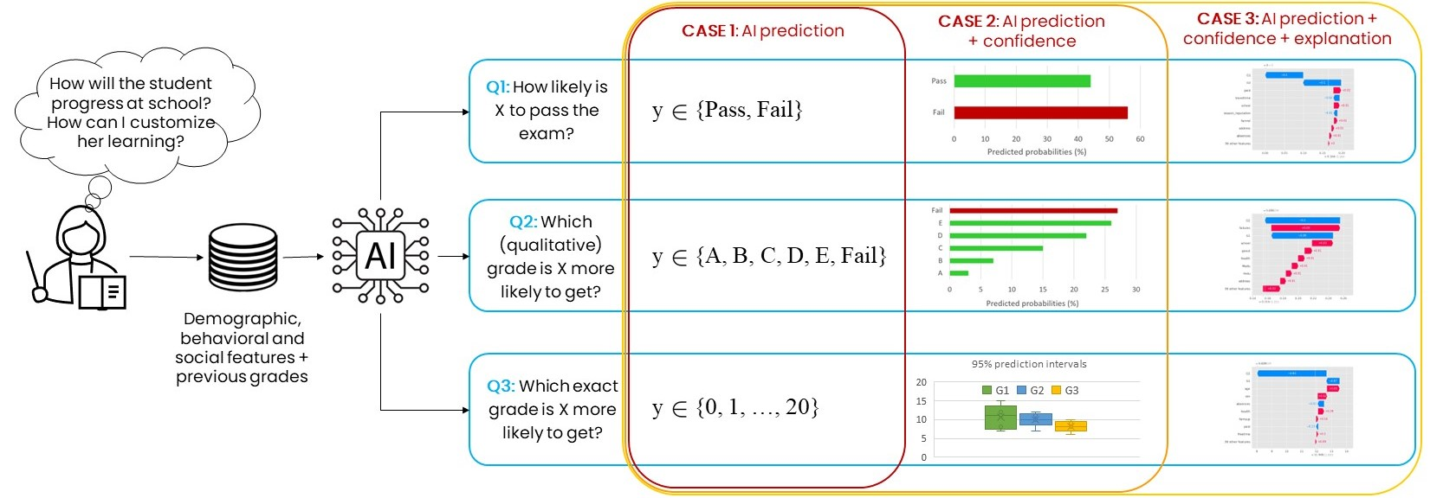
Explanation empowers human oversight over algorithms
Hybrid System

Slide 22
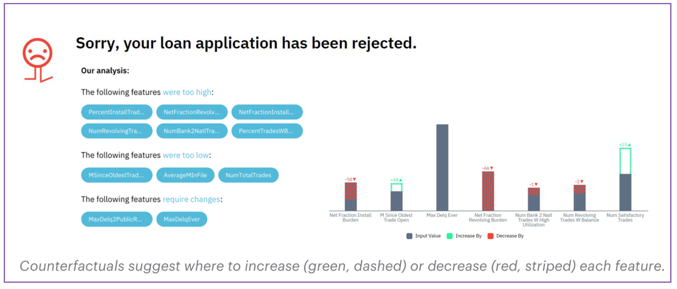
Explanation by counterfactuals empowers what if reasoning

Slide 23
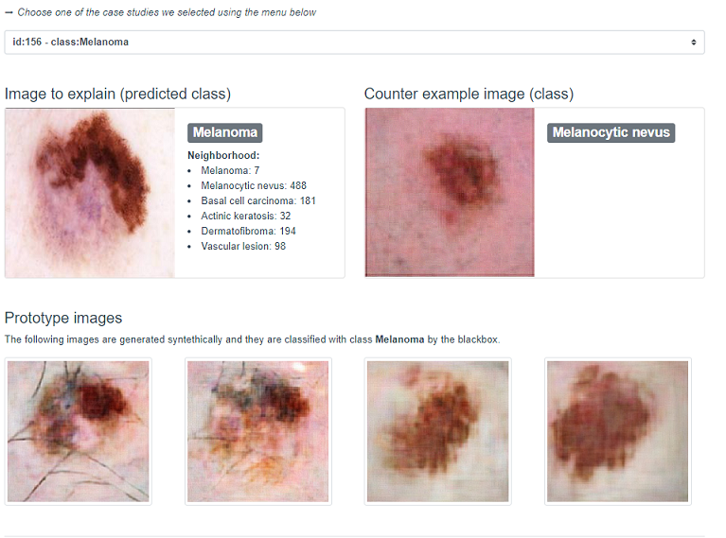
Counterfactual are based on generative AI
Counter-exemplar Melanocytic Nevus (NV)

Slide 24
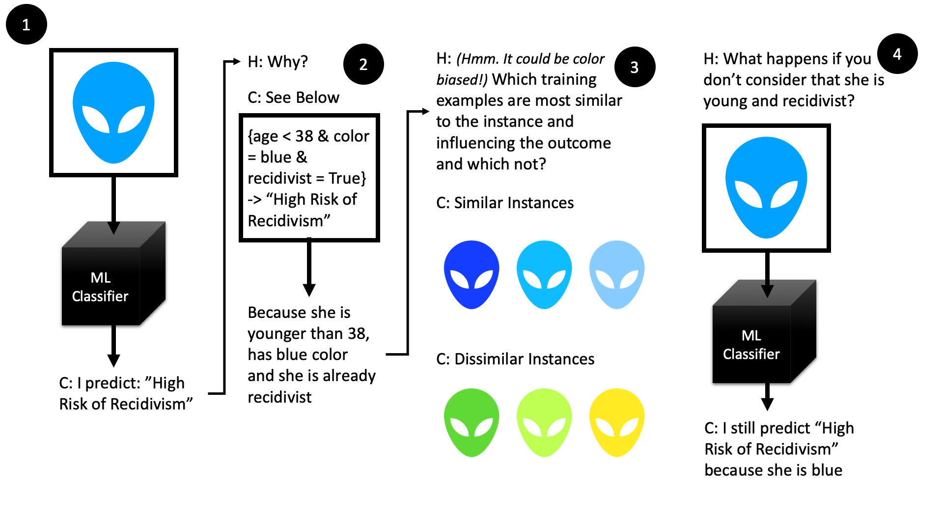
Explanation as a Human-Machine Conversation

Slide 25
ANOTHER PROBLEM: ALIGNMENT
Values are abstract and high level
Values are dependent on the context.
Values have different interpretations in different contexts and cultures.
Algorithmic transparency
/ XAI
choices need be explicit and contextual!

Slide 26
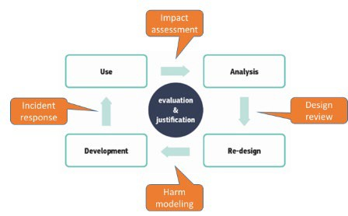
RESPONSIBLE AI LIFECYCLE
Means for accountability
Risk mitigation
Human and environmental wellbeing
Identify stakeholders
Risk assessment
values and requirements elicitation
Data management
Algorithm auditing
Fairness implementation
Consider dual use
Dataset quality and origin
Cost / environmental impact

Slide 27
Discriminative vs Generative AI
Generative model capture correlations such as "things that look like boats are likely to appear near /for images) to things that look like water" and "eyes are unlikely to appear on the forehead".
Discriminative models try to draw boundaries, while generative models try to model the location of data in space.

Slide 28
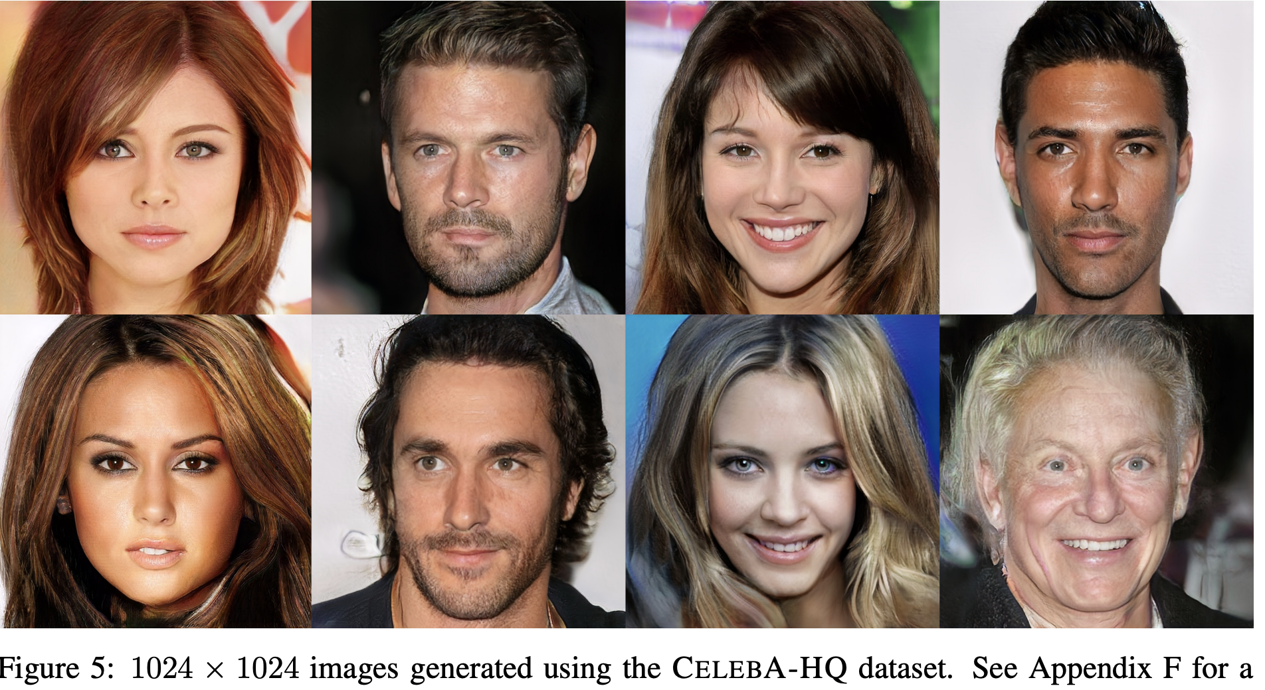
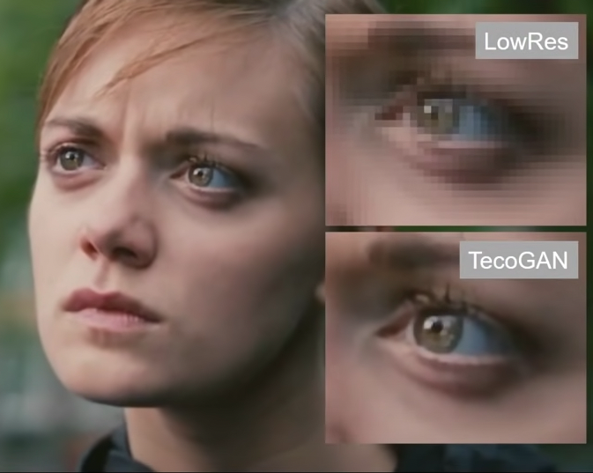
Example of Generative models
Chu, Mengyu, et al. "Learning temporal coherence via self-supervision for GAN-based video generation." ACM Transactions on Graphics (TOG) 39.4 (2020): 75-1.
Karras, Tero, et al. "Progressive growing of gans for improved quality, stability, and variation." arXiv preprint arXiv:1710.10196 (2017).

Slide 30
…many tasks---pieces of decision making

Slide 31
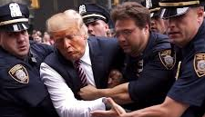
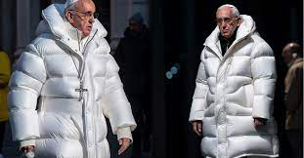
Le trappole
«Prompting» richiede capacità di fare domande e senso critico. Si parla di ingegneria delle domande. Sta diventando una competenza da acquisire.
Robustezza: impara pattern statistici plausibili, ma non necessariamente corretti: allucinazioni
Incorporano bias, stereotipi e valori presenti nei dati disponibili che sono per lo più del «nord globale» per lo più inglese e cinese
Mancanza di multi-lingualità e multi culturalità
Mancanza di trasparenza sui dati di training per poter capire anche la legalità di tali fonti ed i diritti di proprietà
Mancano metodi per distinguere tra contenuti generati da umani o dalla macchina: problema della autofagia.
Aumentare la discriminazione nell’accesso alal conoscenza tra nord e sud del mondo, nonché tra classi sociali di una stessa società

Slide 32
Human or human-like?
Harari dice: la nostra cultura si basa sul linguaggio, se lo fanno le macchine la nostra civiltà va a rotoli e la fiducia calerà
Un tema importante sarà distinguere il manufatto della macchina da quello delle persone
Dove è importante: scuola, lavoro, social media, concorsi etc., ricerca scientifica
Rimedio: strumentare AI generativa con strumenti che a posteriori permettano i contenuti generati, es. watermarking

Slide 33
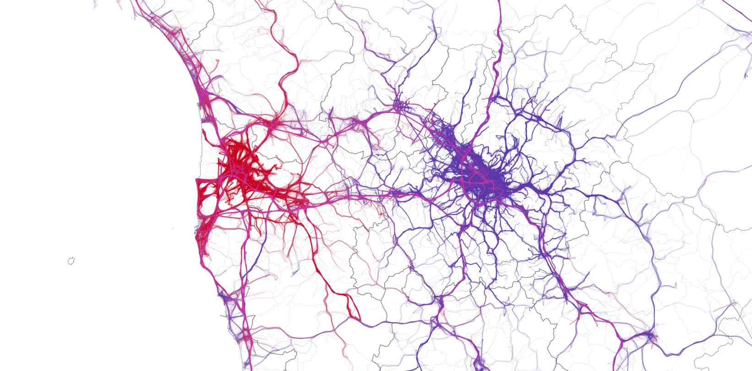
AI la rivoluzione ineluttabile: “non distopia ma utopia possibile”

